Slide 1
Exceeding LEED Parameters
Precepts for Sustainable Master Planned Communities

Slide 2


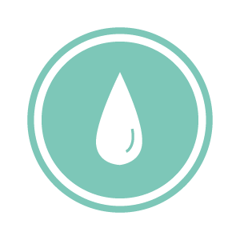



LEED Parameters Met and Exceeded
Eminently Scalable, Thoroughly Sustainable and Fully Translatable
to All Regions of the World
– LEED Platinum Certification
Sustainable Sites
Water Efficiency
Energy and Atmosphere
Materials and Resources
Indoor Environmental Quality
Innovation in Operations & Regional Priority

Slide 3
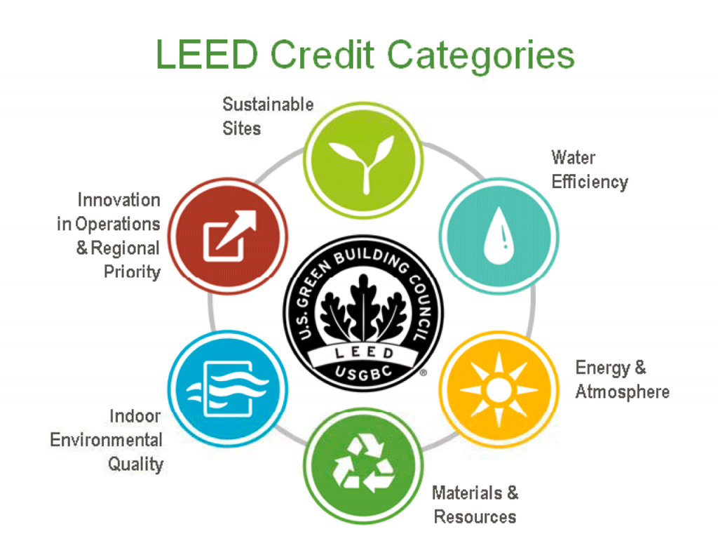
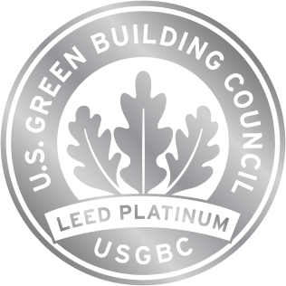
LEED Platinum Certification –
A: Sustainable Sites
This Design is to acquire LEED Platinum status as it conforms to or exceeds LEED parameters in its focus on innovative environmental solutions to ongoing issues.
“The first category of LEED prerequisites and credits [, Sustainable Sites,] has to do with the location and piece of land the project is built on. LEED Sustainable Sites credits
deal[ing] with protecting natural habitat,
keeping open spaces,
dealing with rainwater,
[managing] heat islands and
[reducing] light pollution.”
As this 200-acre parcel has 38% of its area under FEMA Zone AH flood-plain, and 22 acres is Xeroriparian Zone C preserve, we take pleasure in utilizing the area as an opportunity to educate the public on the value of natural resources and related habitats.

Slide 4
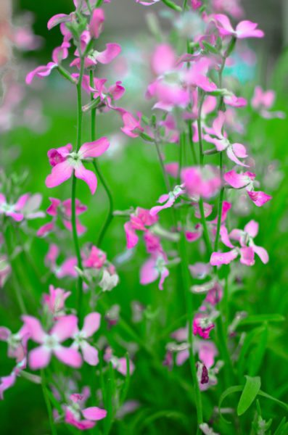
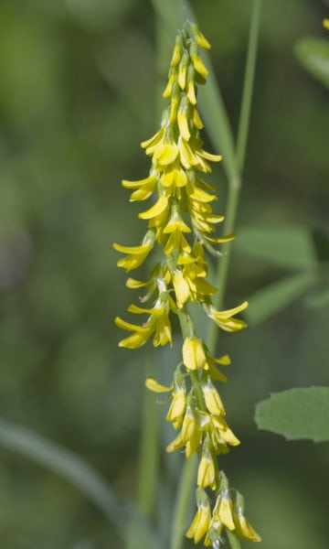
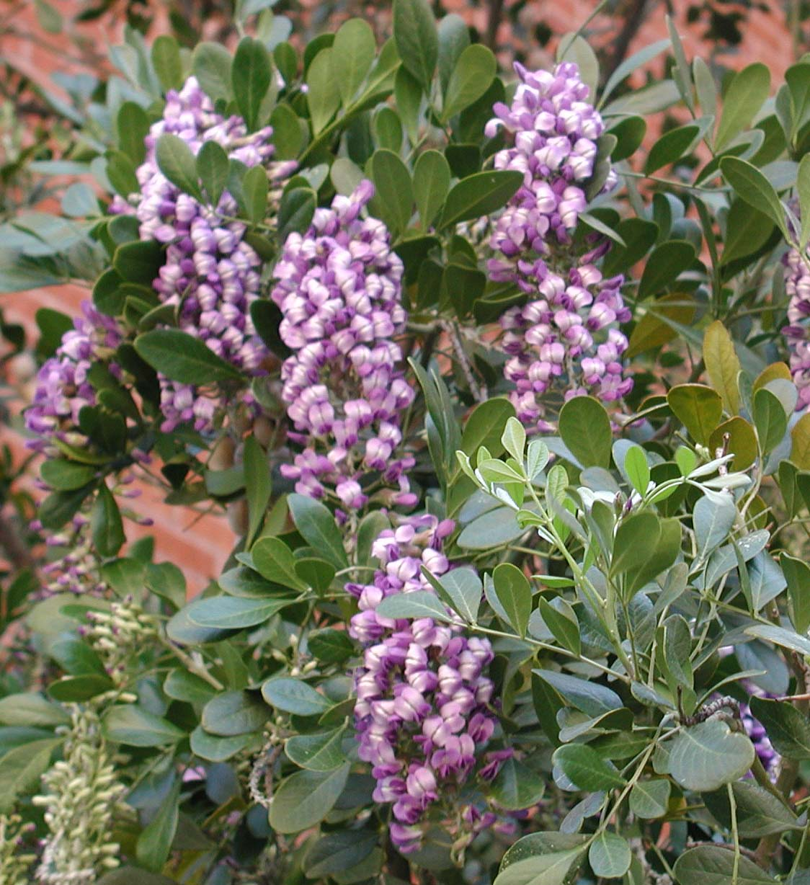
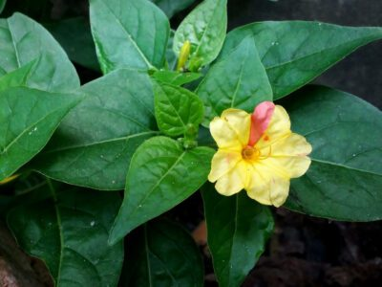
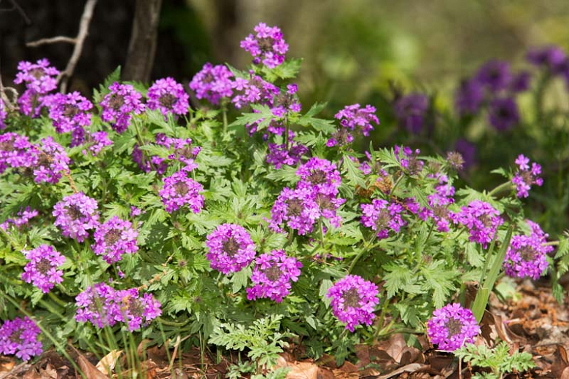
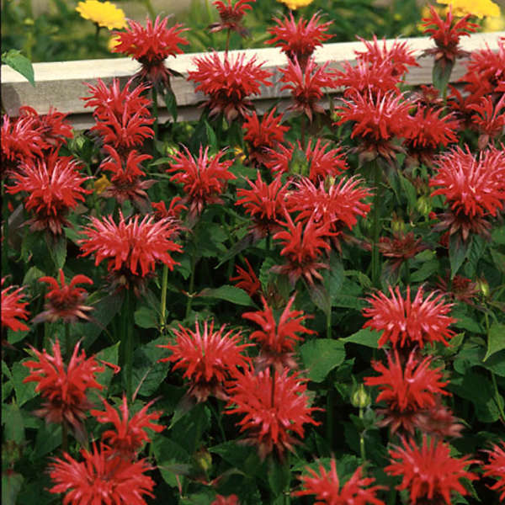
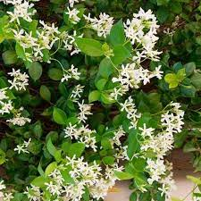
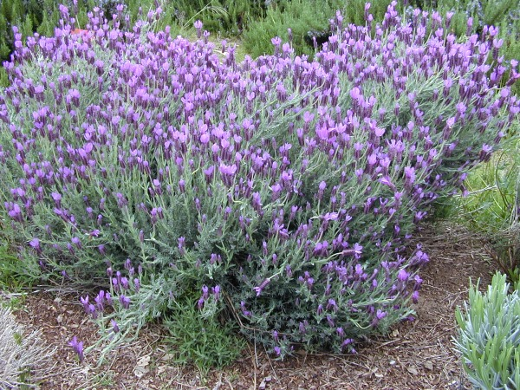
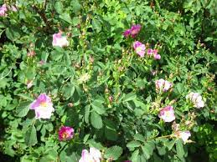
LEED Platinum Certification –
A: Sustainable Sites
Rainwater is minimal in this region. The shrubs, lavender, and grape varieties that we will be growing outdoors in this region are naturally drought resistant, and they will thrive under the natural annual/semiannual inundations.
These species are grown for their pleasant fragrances for both residents strolling through the groves and for harvesting and onsite processing of their aromatic oils for cosmetic and salable private label spa products we will produce.
Yellow sweetclover
Prairie verbena
Glandularia bipinnatifida
Mililotus officianalis
Four o'clocks
Mirabilis multiflora
Texas mountain laurel
Night scented stock
Dermatophyllum secundiflorum
Matthiola longipetala
Star jasmine
Trachelospermum jasminoides
Spanish lavender
Scarlet beebalm
Monarda didyma
Desert rock rose
Lavandula stoechas
Cistus

Slide 5
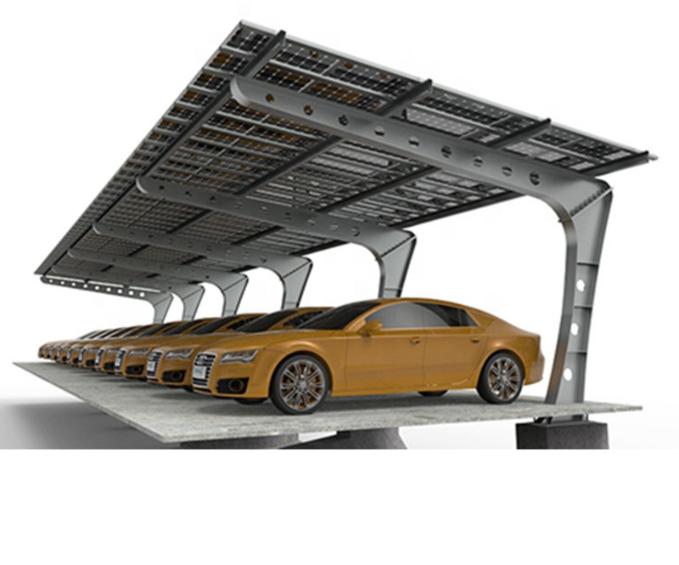
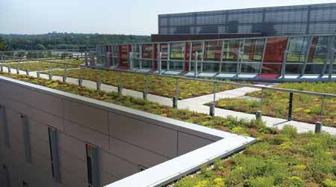
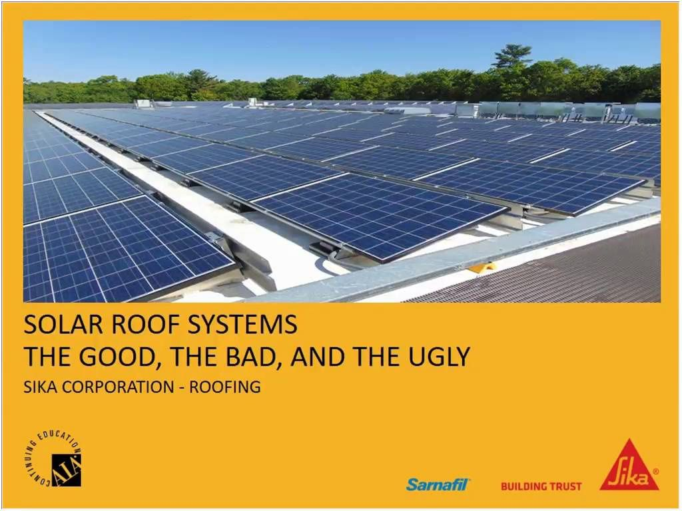
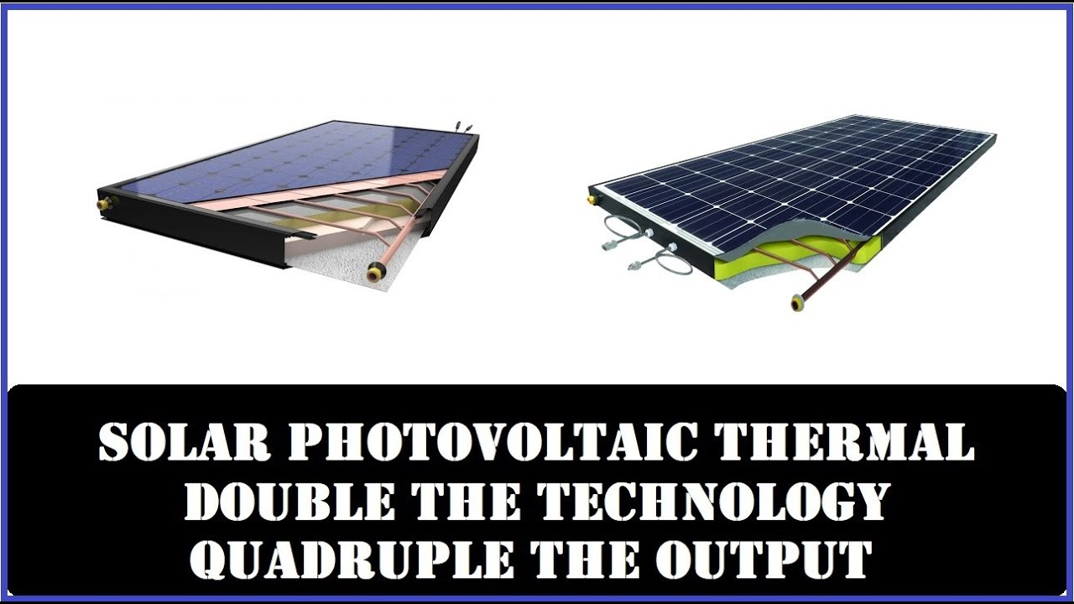
LEED Platinum Certification –
A: Sustainable Sites
Heat islands are mitigated with vegetative roofs, or structures with energy-capture measures.
The six acres of parking that surrounds the waterpark are protected from heat generation with parking area roof structures, and they provide additional photovoltaic solar panel surfaces.
To keep the solar panels operating at optimal efficiency, hybrid passive and active (PV) solar panels are employed to cool the PV panels to maintain optimal efficiency, while simultaneously preheating water (with its turbidity having been removed through pre-filtration) to be sent to the distillation boilers, minimizing the energy required to raise the wastewater temperature to boiling via the thermal transfer of high-temperature silicon material that photovoltaic panels can potentially reach in the Sonoran Desert.
Most structures will have hybrid PV/Passive solar panels and reflective, light-colored walkable roofs, which minimizes heat island pollution and maximizes PV panel efficiency.

Slide 6
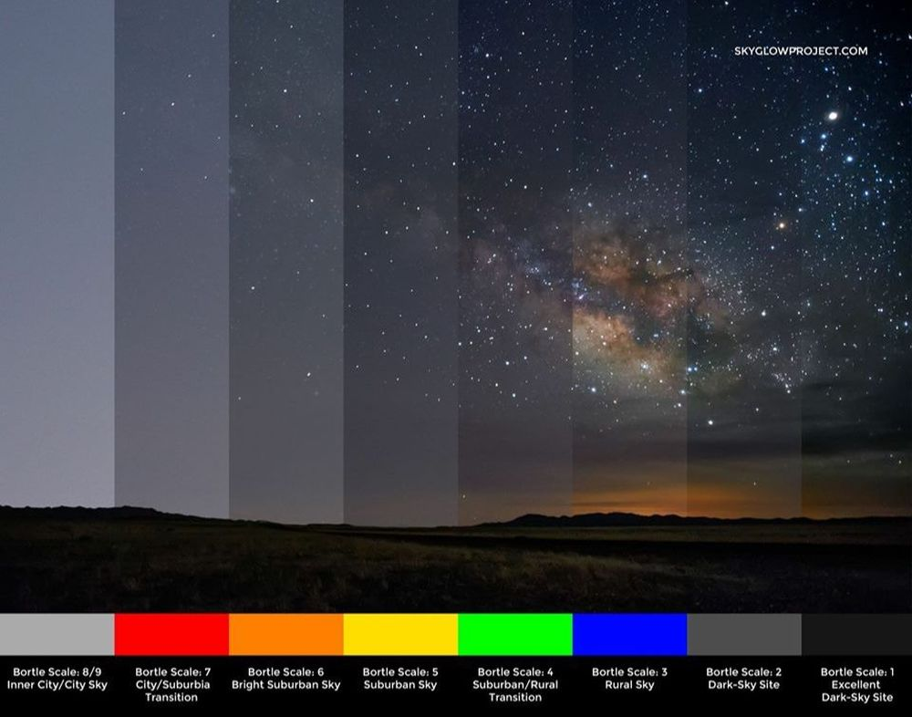
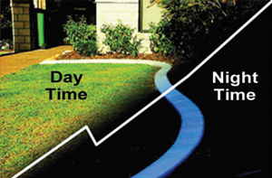
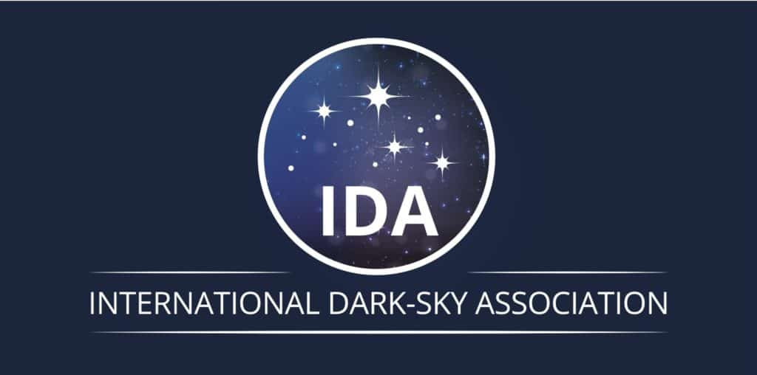
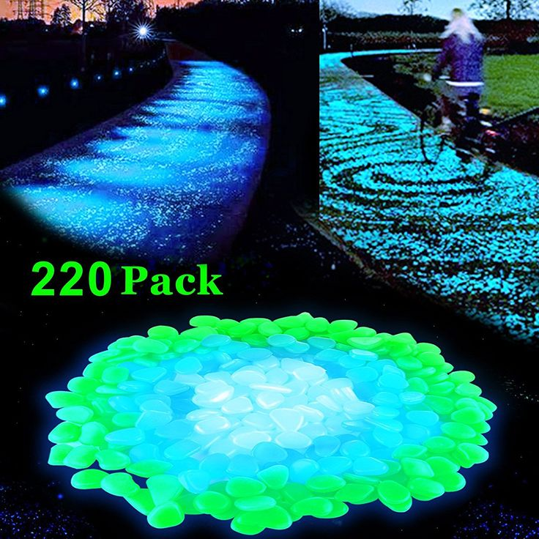
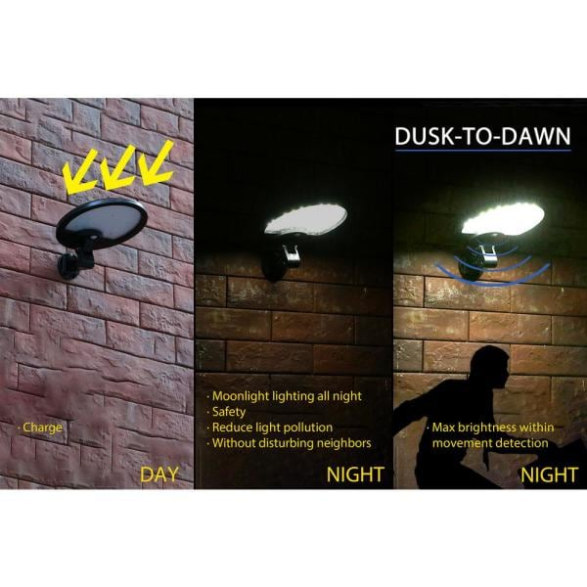
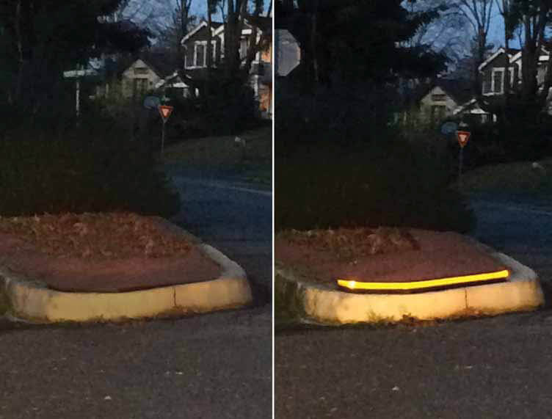
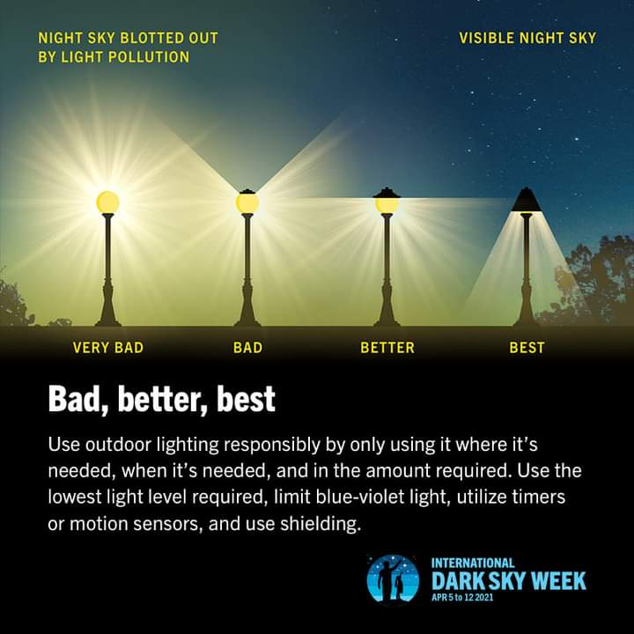
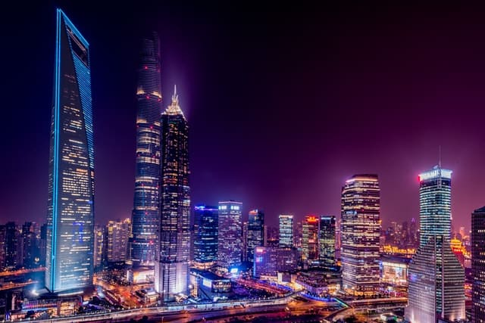
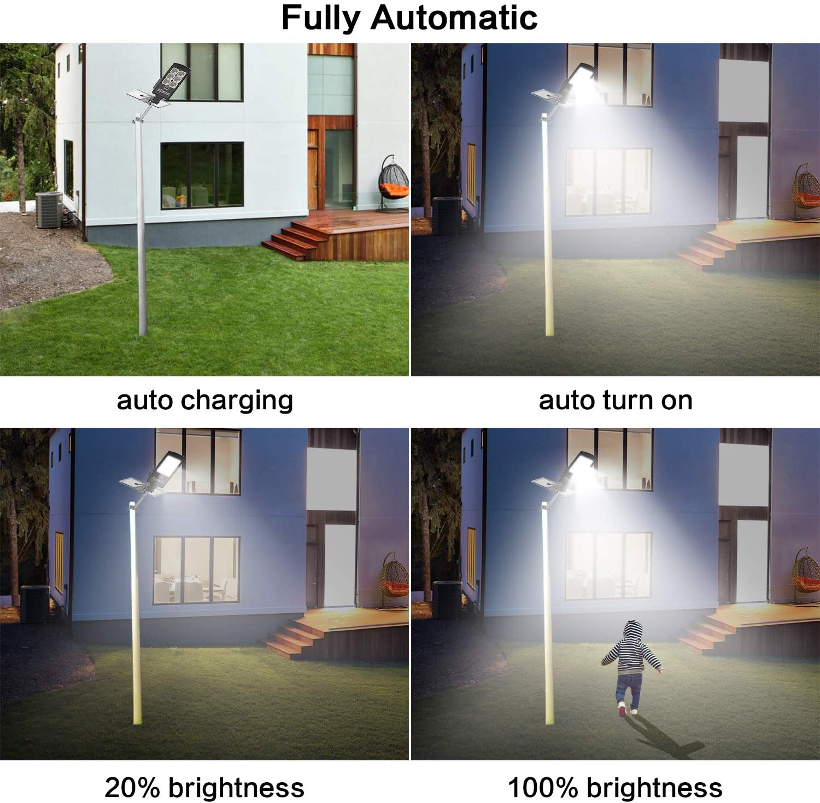
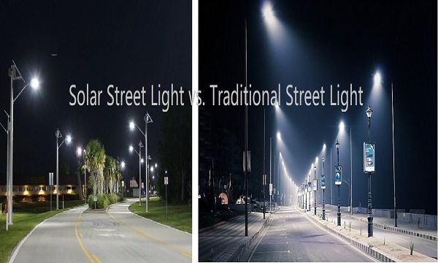
LEED Platinum Certification –
A: Sustainable Sites
This design acknowledges the existing RH zoning parameter, such that building heights are not to exceed 35’.
Reflection of glass into the atmosphere from skin buildings is not irrelevant to this development. Light Pollution Reduction is therefore easily managed.
Streetlamps and front yard lamps are to be on automatic light sensors. Low-hanging, hooded, warm LEDs reduce light pollution.
Where lighting is needed for security, properly-calibrated and properly-positioned motion-sensor lamps are to be used.
Road reflectors, reflective curbs, paint, glow stones, and guardrails are to mitigate drivers’ needs to use their high beam lamps.
General use of the Bortle Scale and the IDA (International Dark Sky Association) products and conformity to IDA regulations are to be observed.

Slide 7
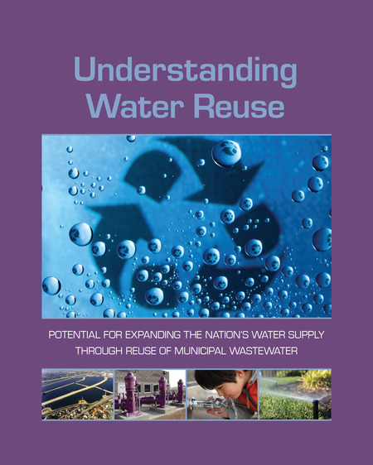
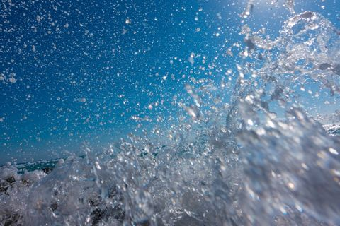

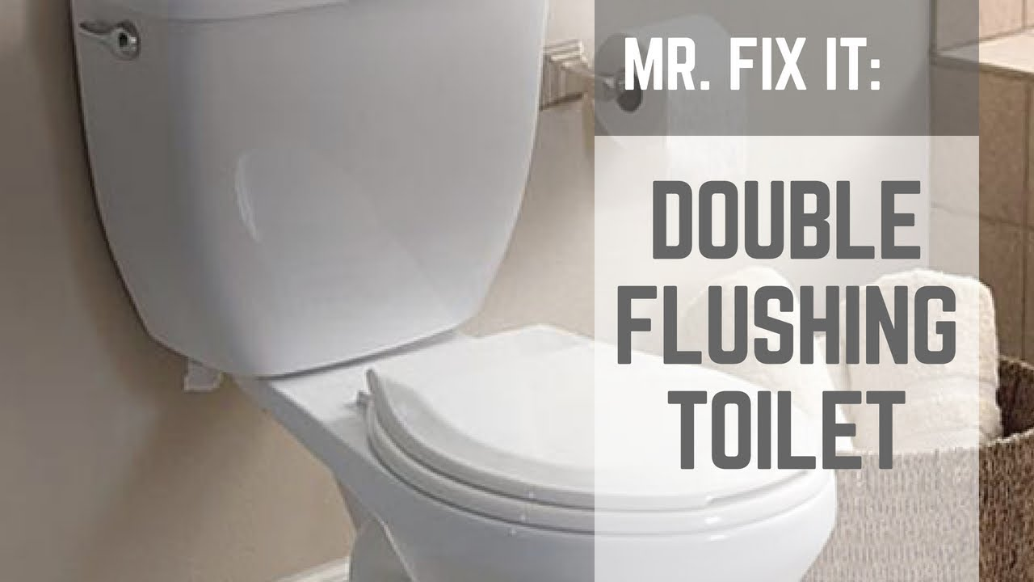
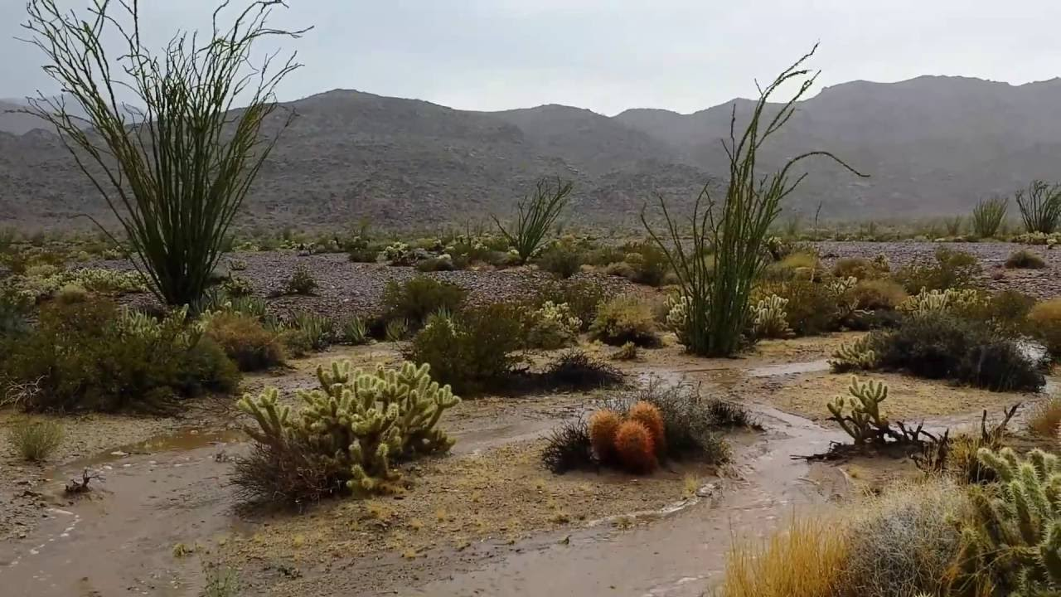
LEED Platinum Certification –
B: Water Efficiency
“OUTDOOR WATER USE REDUCTION
Eliminating the need for outdoor irrigation entirely—or reducing the landscape watering requirement by at least 50%—can earn a project up to two points.”
All OUTDOOR agricultural irrigation is to be natural, in that all adult plants transplanted to the flood zone will benefit from the inundation that occurs naturally.
“INDOOR WATER USE REDUCTION
Reducing indoor water use beyond the 20% prerequisite can earn a project more points, with up to six points awarded for reductions of 50% or more.”
This design does not require a minimization of water use of its residents and businesses. Rather, the zero-energy wastewater treatment facility provides everyone in the community with very well purified, potable water on an on-going basis.
Therefore, as water is consistently reclaimed and purified, there is little-to-no-reason to minimize water use – agriculturally, commercially or individually.

Slide 8
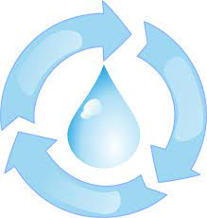
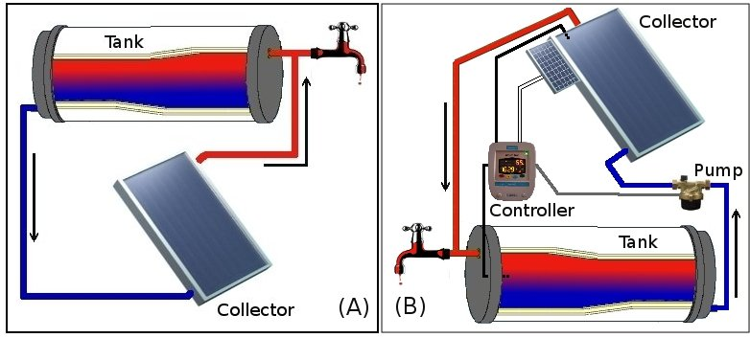
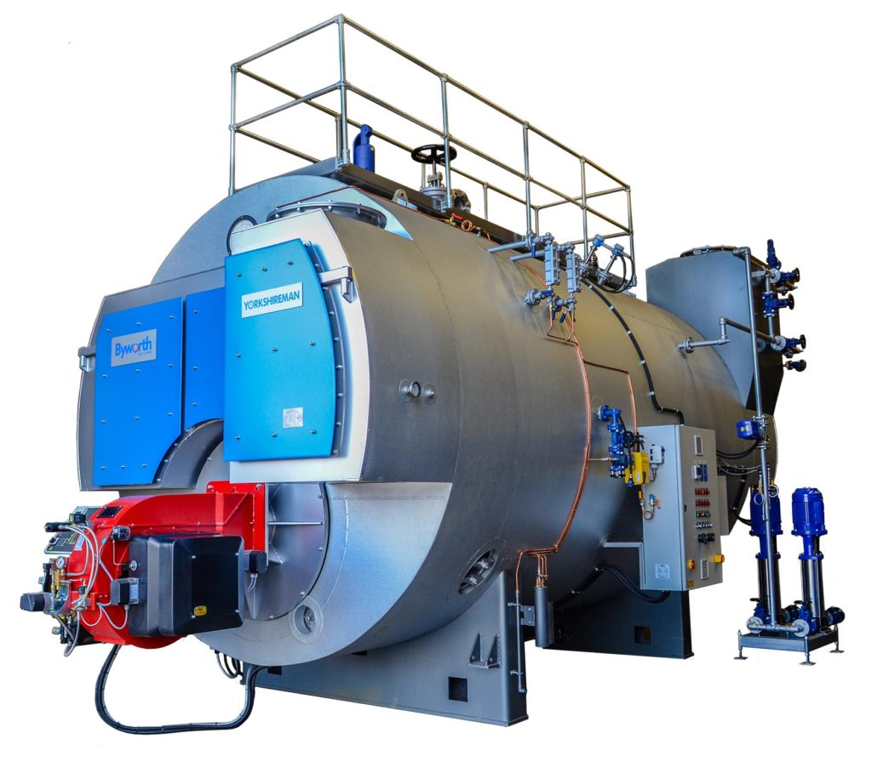
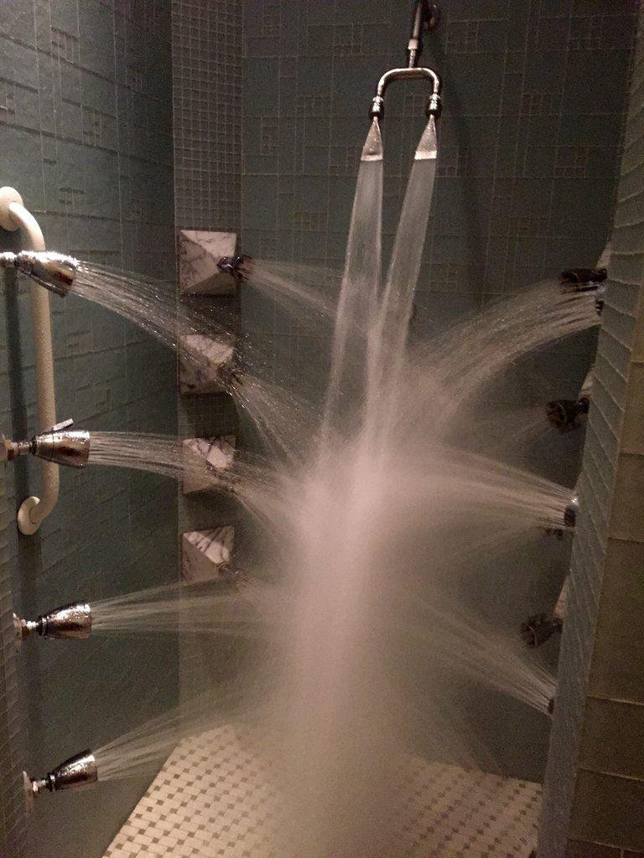
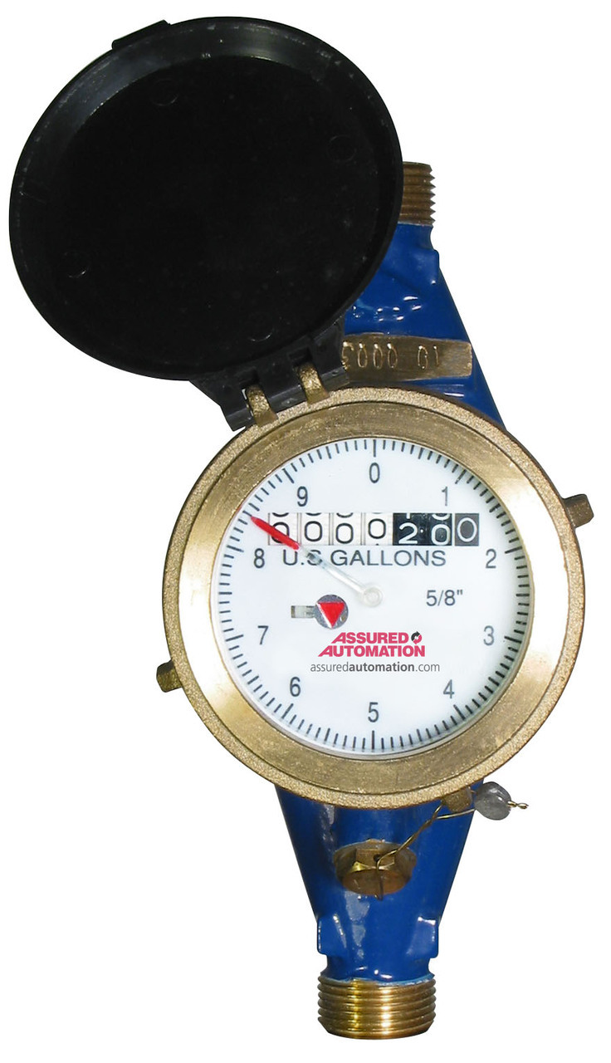
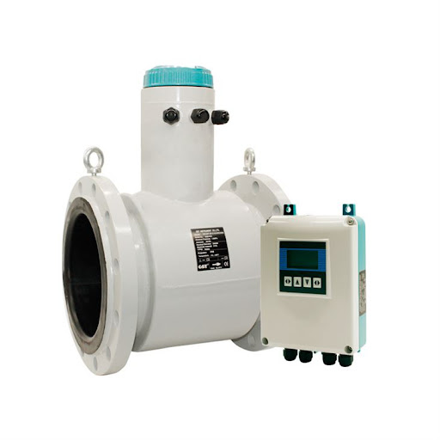
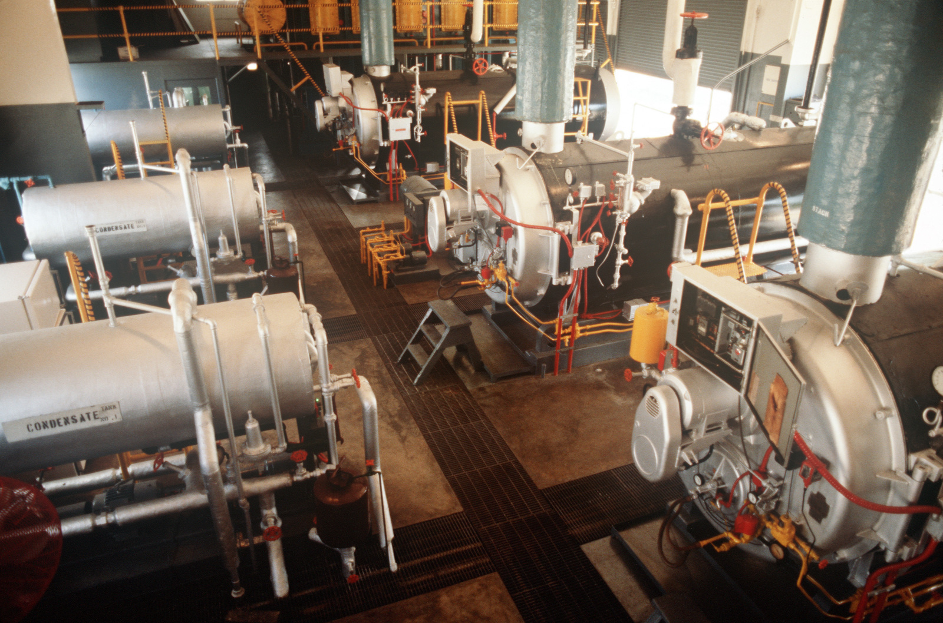
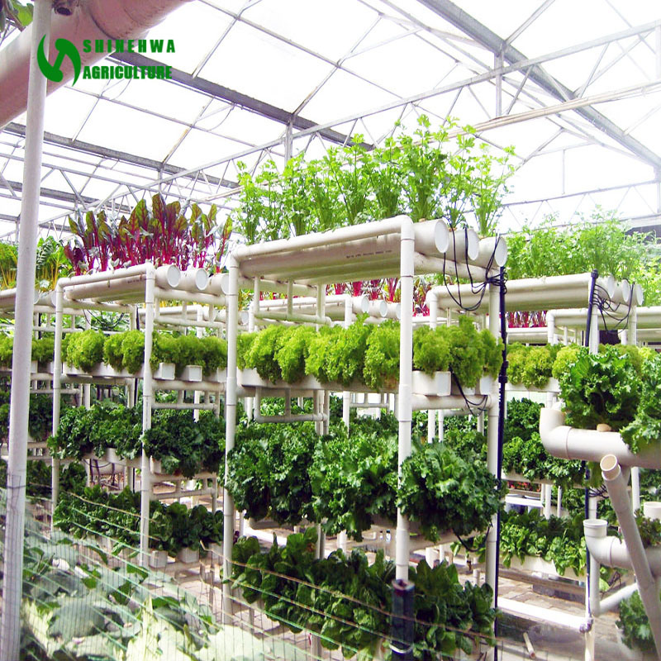
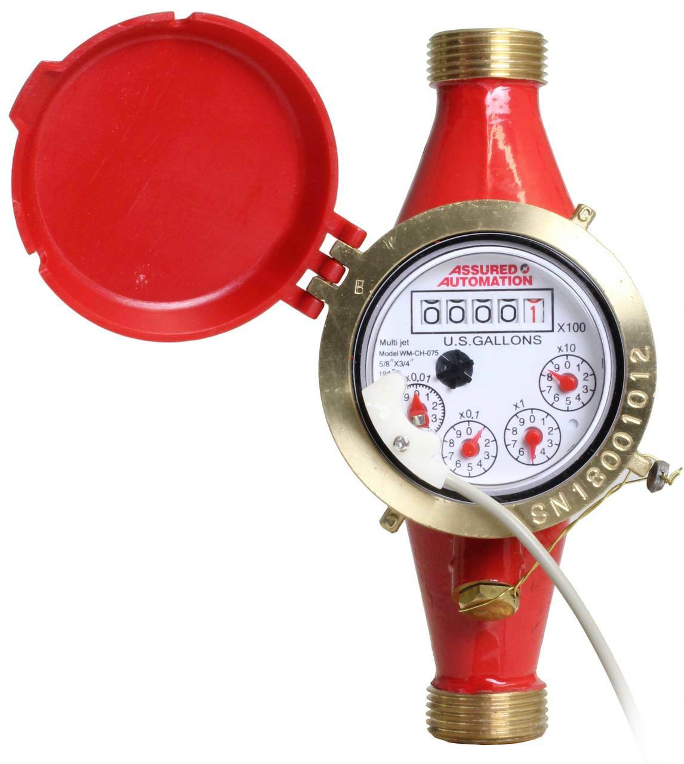
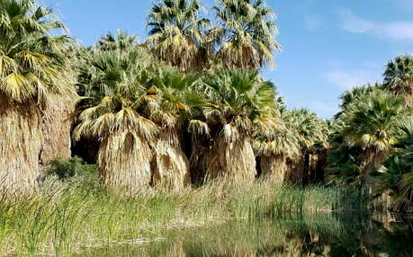
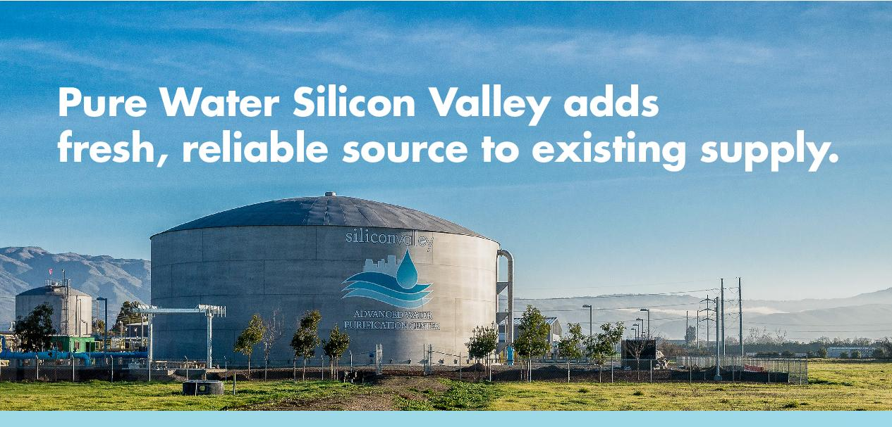
LEED Platinum Certification –
B: Water Efficiency
“COOLING TOWER WATER USE [parameters applied to onsite wastewater treatment facility]
WATER METERING
Since you cannot manage what you don’t measure, a water meter is the best way to identify high-water use areas and leakage. Projects that sub-meter at least two water end uses are awarded one additional point.
Another new credit requires permanent water meters for two or more of the following water subsystems:
  Irrigation
  Indoor plumbing fixtures and fittings
  Domestic hot water
  Boilers
  Reclaimed water
  Other process water”
In response to the list directly above, water conservation is achieved with the following applications of technologies:
Irrigation losses to evapotranspiration are well mitigated with water-saving vertical farming.
Indoor plumbing and fixtures are disregarded as they are infuriating to the consumer and are wholly antithetical to their purpose of minimizing water use.
Commercial and Domestic hot water is achieved by using both Passive and Active (PV) solar heating.
Boilers (used to achieve distilled water found within the onsite water purification system) are among the most critical elements of this design, which eclipses the need for other, less-effectual water-saving measures.
Reclaimed water is achieved with water purification through zero-net energy distillation to potability.

Slide 9
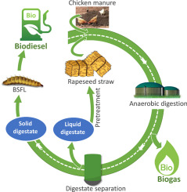
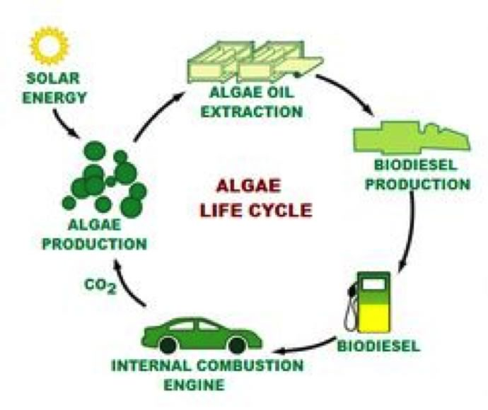
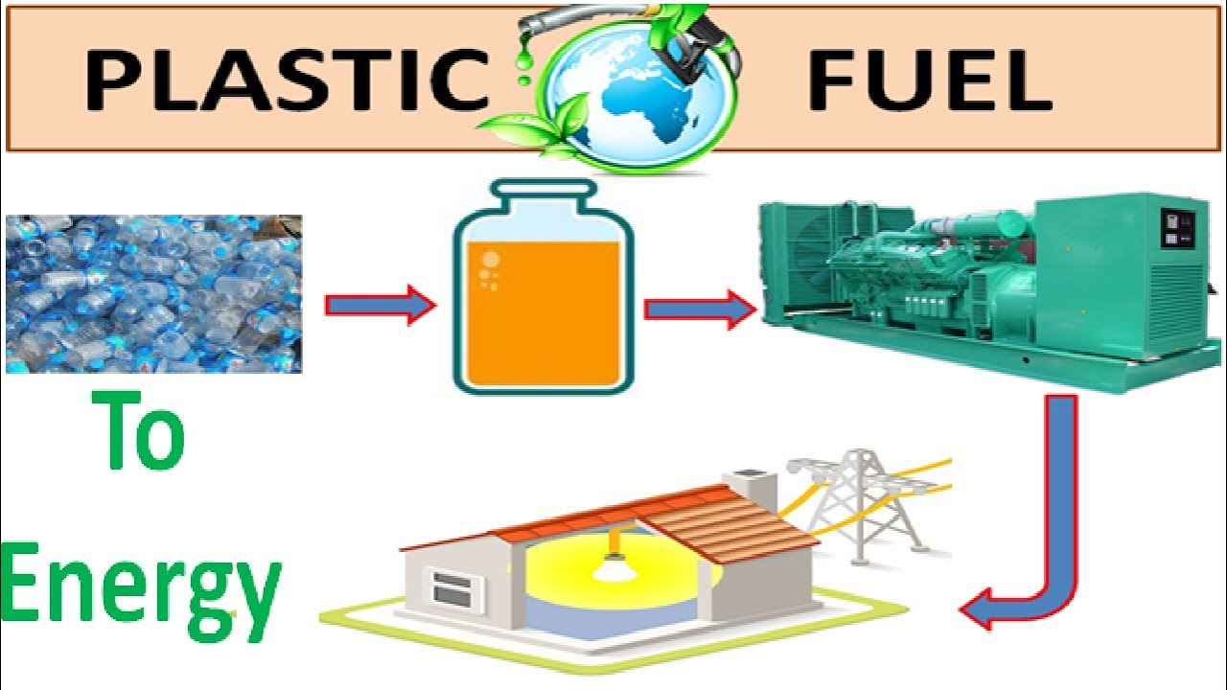
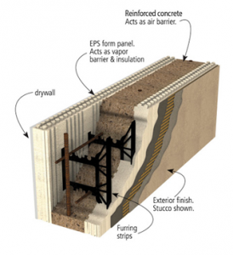
LEED Platinum Certification –
C: Energy & Atmosphere
“The primary goal of the Energy and Atmosphere [category] is to minimize the use of fossil fuels. The LEED Certification category of Energy & Atmosphere promote better building energy performance through innovative strategies.”
Through our Pyrolysis of specific chemical profiles of our solids waste, we are generating synthetic analogs to fossil fuels. Additionally, we generate our own series of saleable Biofuels from a variety of agricultural wastes.
“LEED certified buildings reduce stress on the environment. They are more energy and resource-efficient. They generate less waste and lower the use of energy, water, and other resources. Points can be earned for storage and collection of
recyclables,
renewable energy use, and
indoor water use reduction.”
For the non-recyclable sludge and solids waste, we will be encapsulating those waste products (reduced to salts and pyrolytic ash) in signage and other non-structural materials, rendering them inert and therefore no longer a threat to the environment.
Salts and Residual Sludge
EPS Structural
Insulation
Exterior Finish
Stucco
Spacing
Strips

Slide 10
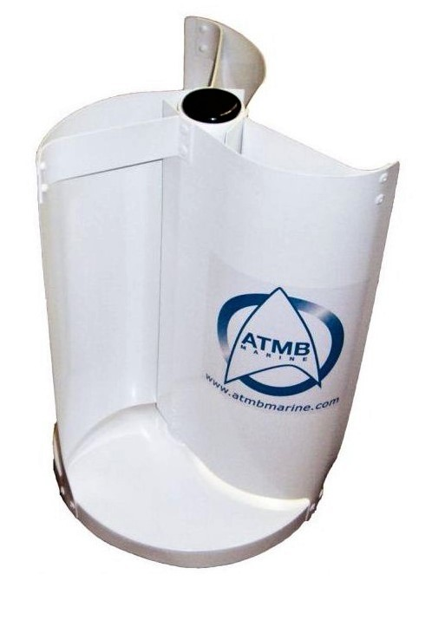
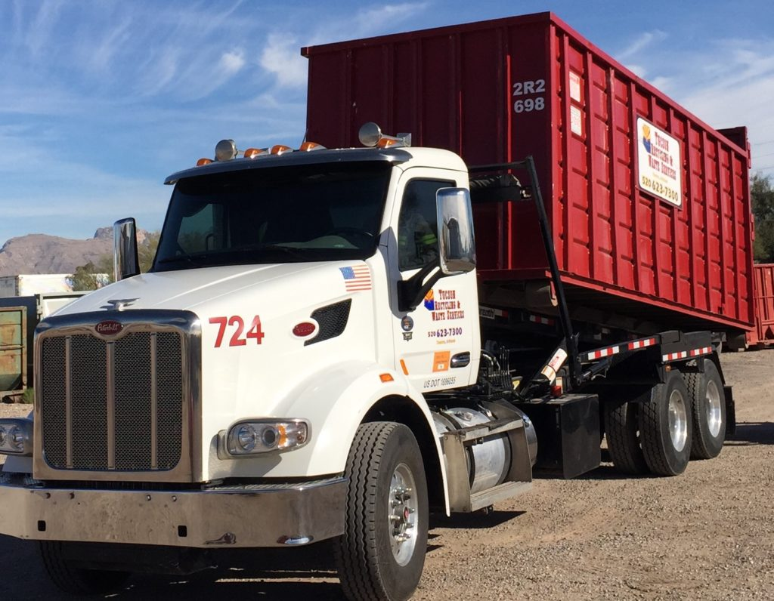
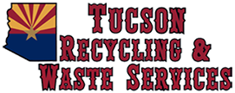
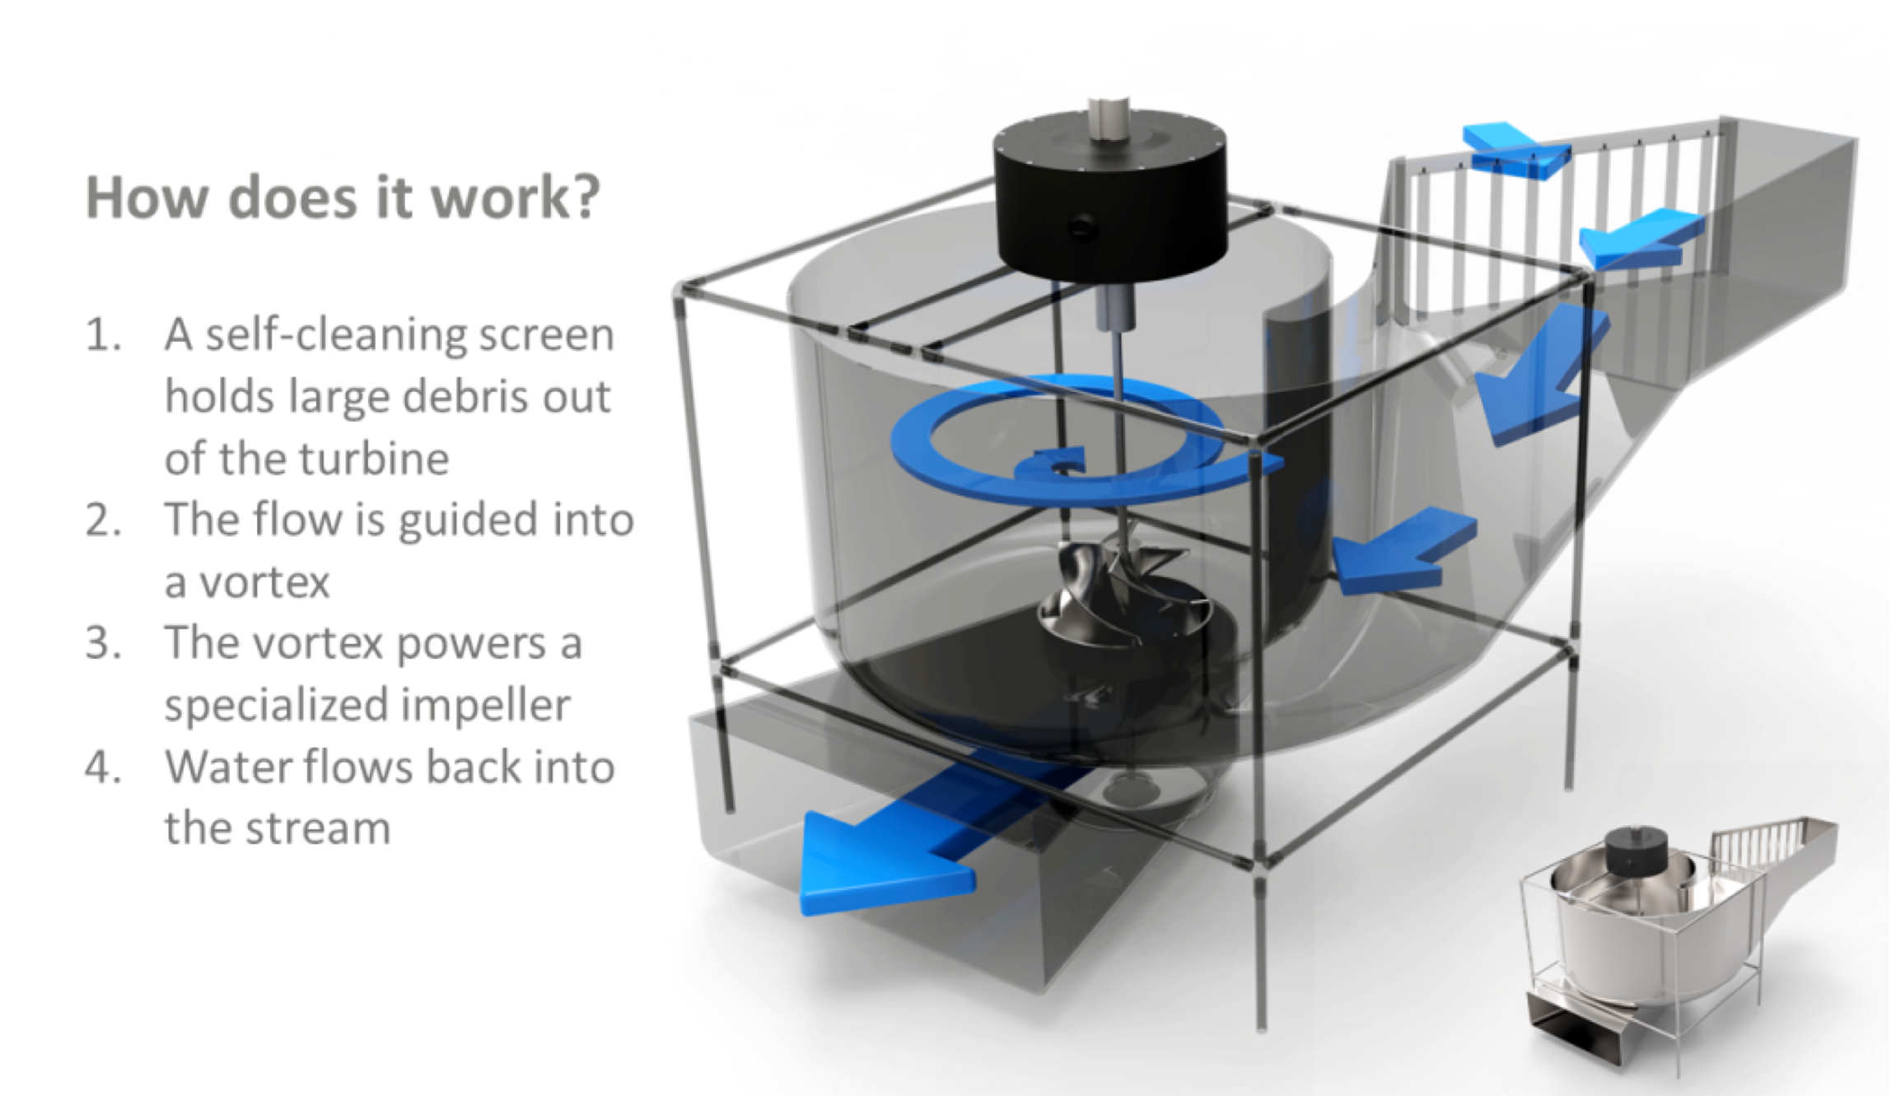
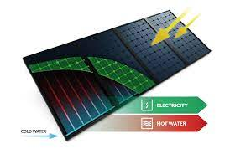

LEED Platinum Certification –
C: Energy & Atmosphere
“LEED certified buildings reduce stress on the environment. They are more energy and resource-efficient. They generate less waste and lower the use of energy, water, and other resources. Points can be earned for storage and collection of
recyclables,
renewable energy use, and
indoor water use reduction.”
Recyclables are collected and managed by Tucson Recycling and Waste Services.
Renewable energy use is inherent to the development as we employ:
Wind Energy
Passive and Active Solar Energy
Hydrological Kinetic energy
Recaptured Heat Energy
Biofuels from Agricultural Waste
Indoor water use reduction is discouraged for three reasons:
Consumers find water use reduction infuriating and uncomfortable
The measures and technologies which reduce water usage are inferior as they typically require further flushing or washing with more water than was originally used, and
Water reduction inherently increases loads for the very water purification that we will be employing, which is among the main features of this sustainable development.
Indoor water use reduction is discouraged for three important reasons that must be acknowledged by the sustainability community:
The measures and technologies which reduce water usage are inferior as they typically require further flushing or washing with more water than was originally used, and
Consumers find water use reduction infuriating and uncomfortable
Water reduction inherently increases loads for the very water purification that we will be employing, which is among the main features of this sustainable development.
Active
Passive
Water recirculation to potability, combined with evaporation mitigation measures, must therefore be the principal set of solutions to water issues in the Sonoran Desert.

Slide 11
LEED Platinum Certification –
D: Materials & Resources
The following are the top 15 sustainable and green building materials in construction:
Bamboo
Precast Concrete Slabs
Cork
Straw Bales
Recycled Plastic
Reclaimed Wood
Reclaimed or Recycled Steel
Plant-based Polyurethane Rigid Foam
Sheep’s Wool
Rammed Earth
Hempcrete
Mycelium
Ferrock
Timbercrete
Terrazzo

Slide 12









LEED Platinum Certification –
D: Materials & Resources
Most all of the top 15 sustainable and green building materials are to be used in both commercial and residential construction.
Bamboo is a strong, resilient, wholly renewable flooring, countertop, rug, furniture, and textile material.
Precast Concrete/Fibercrete Slabs will be used for the secure estate fencing throughout the community.
Cork can be utilized in both kitchen and bath applications, and it is wonderfully comfortable underfoot and as a mitigation to joint damage.
Straw Bales for fine home construction have been perfected by an architect, who has produced mansions with haybale construction.
Recycled Plastics are used in some of the solar energy substrates and small-scale wind turbines
Reclaimed Wood may be used to form naturalistic partitions and interior siding.

Slide 13





LEED Platinum Certification –
D: Materials & Resources
Most all of the top 15 sustainable and green building materials are to be used in both commercial and residential construction.
Reclaimed or Recycled Steel may be used in some minor structural spans.
Polyurethane Rigid Foam is to be widely used as it is the major structural element in the Green Rhino Building System mentioned above. Plant-based EPS can be used for non-structural applications.
Sheep’s Wool has a variety of residential and commercial applications that we will explore on a case-by-case basis.
Rammed Earth is to be used for certain structures. Its natural striations are beautiful.
Hempcrete may become one of the industries that we employ for our economic sustainability, as well as utilize its inherent ecological sustainability.

Slide 14




LEED Platinum Certification –
D: Materials & Resources
Most all of the top 15 sustainable and green building materials are to be used in both commercial and residential construction.
Mycelium is a sustainable material principally used in packaging. Per agricultural product, we will assess the viability of packaging produce and animal products in mycellium.
Ferrock is a relatively new construction material, which has application to construction of the school, the recreation center and the museum.
Timbercrete is like hempcrete in that cellulose fibers from sawdust contribute the tensile strength to concrete blocks as their manufacturing is enhanced by the addition of fibrous material.
Terrazzo will be the flooring for the school, the recreation center and the museum. Vertical surfaces and exterior applications prevail.

Slide 15



LEED Platinum Certification –
E: Indoor Air Quality
“In LEED, the Indoor Environmental Quality category addresses design strategies and environmental factors — such as
air quality,
lighting quality,
acoustic design and
control over one's surroundings
— that influence the way people learn, work and live.”
This development has the advantage of applying a series of closed systems, not the least of which is a new, highly-efficient construction method employing encapsulated EPS. It allows for complete air quality control by virtue of the construction method, which locks in and out humidity and impurities.

Slide 16


LEED Platinum Certification –
E: Indoor Air Quality
“In LEED, the Indoor Environmental Quality category addresses design strategies and environmental factors — such as
air quality,
lighting quality,
acoustic design and
control over one's surroundings
— that influence the way people learn, work and live.”
As this is a new development, state-of-the-art lighting technologies are to be used per new construction.
Sound transfer is minimized by this insulative structure when compared to standard stick or concrete construction.

Slide 17


LEED Platinum Certification –
E: Indoor Air Quality
“In LEED, the Indoor Environmental Quality category addresses design strategies and environmental factors — such as
air quality,
lighting quality,
acoustic design and
control over one's surroundings
— that influence the way people learn, work and live.”
Smart home technologies are designed to manage and control the air quality, lighting quality, and influence acoustic elements within a space.
Some smart home technologies analyze both influent and effluent water of each home or business. This provides us an immense advantage as the managers of water quality and wastewater treatment within the development.

Slide 18
LEED Platinum Certification –
F: Innovation: O & RP
“This credit is worth 1-5 points. Projects can earn additional credits for innovations in green building. There are three ways to earn credits in this section:
(1) Achieve significant, measurable environmental performance using a strategy not included in the LEED rating system;
(2) Achieve a pilot credit not currently included in an existing rating system from USGBC’s Pilot Credit Library; or
(3) Achieve exemplary performance of an existing LEED prerequisite or credit as per the Reference Guide (usually defined as double the existing threshold or at the next incremental percentage threshold).”

Slide 19









LEED Platinum Certification –
F: Innovation: IO & RP
In reviewing the 112 Credit system, this development will easily achieve significant, measurable environmental performance.
We may also achieve pilot credits not currently included in the existing rating system from USGBC’s Pilot Credit Library
Most notably, we can easily achieve exemplary performance of existing LEED prerequisites and credits per the Reference Guide.
As LEED point metrics are constantly being updated, these achievements are to be fully quantified closer to the time of construction.
https://www.usgbc.org/credits

