Slide 1
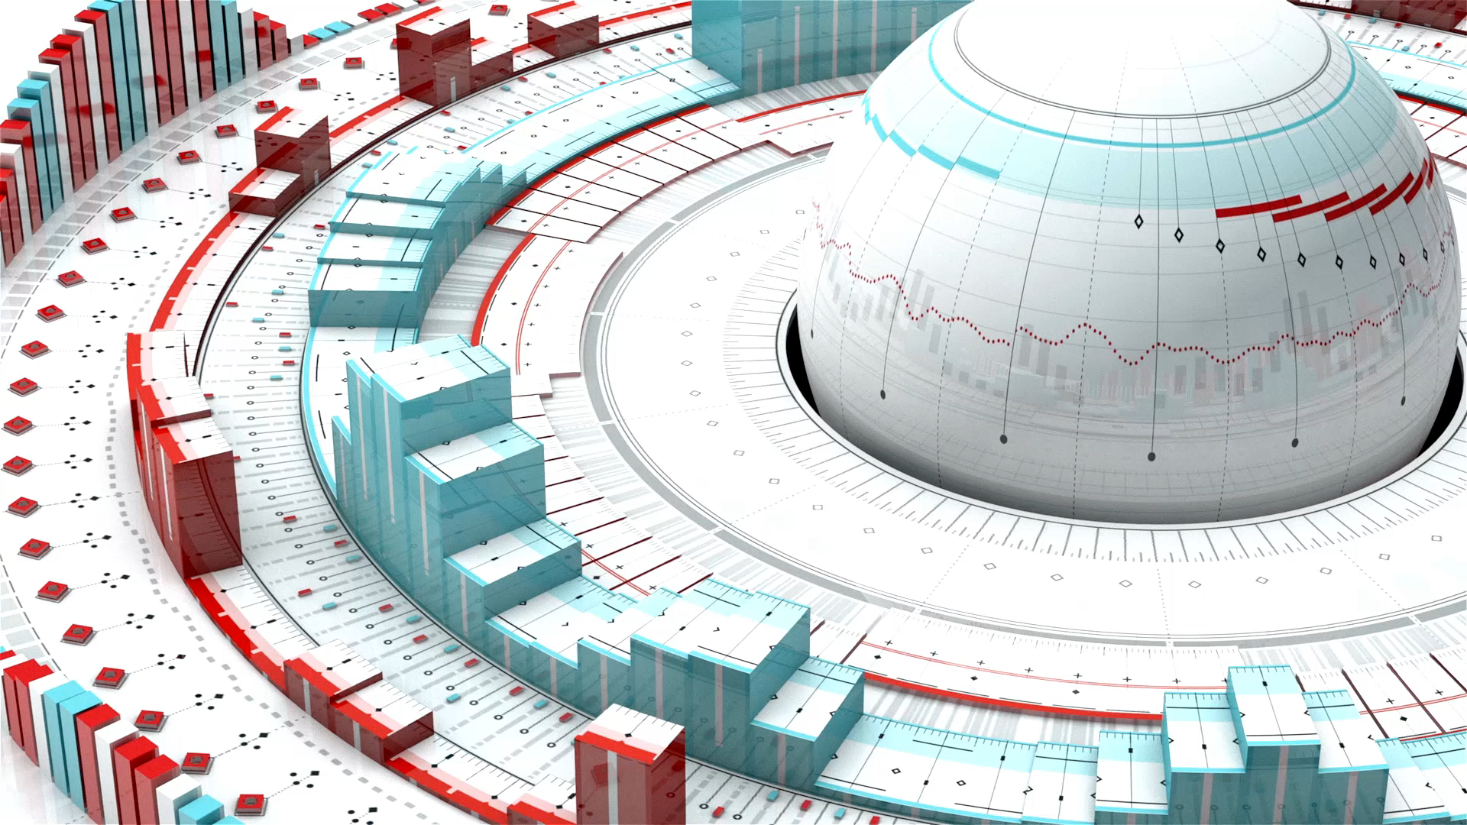
The Circular Economy
as Applied to Master Planned Community Infrastructure
for the Purposes of Properly and Efficiently Changing Legislature

Slide 2
The Circular Economy
The following slide is an animation that shows the circular flow from initial extraction of water needed to fill the needs of the entire master planned community as the initial step to the complete circular economy in which
all water is economically treated to potability
all wastes are converted to useable and saleable biofuels
all food is grown in CEA structures for the purposes of the community’s food security and for investors’ income streams
ancillary biofuel and onsite food supply markets and income streams are created
as Applied to Master Planned Community Infrastructure
for the Purposes of Properly and Efficiently Changing Legislature

Slide 3
Bi
Income Streams:
Sale of Biofuels, Produce, Fish, Electricity
Fresh Water
Regenerable Biochar to
Pre-RO as a Filtration Medium
Pre-RO
Sewage
Treatment
Sewage
Solids Wastes
Circulated in a Separate
Plumbing System to a
Separate Pyrolysis System
Income Streams:
Packaging and Sale of Milk, Cheeses, Eggs, Other Dairy and Apiary Products
Turbine Conversion of Biofuels to Electricity
Process Water to Purification
One-Time Draw from Original Source
(Aquifer)
Offsetting/Replacing of Electricity Costs of Running Data Center
Biofuels Recirculated to All Processes
RO (Reverse Osmosis) and Nano Filtration
Treatment
to Potability
Apiary for Food, Pharmaceuticals, and Cosmetic Manufactory
Useable/Saleable Biofuels,
Biogases,
and Biochar
Solids
Wastes
Waste-water
Milk and Egg
Dairy
Restaurants
and Grocery
Potable Water: Local Distribution
to all Businesses
and Residences
Pyrolysis
to Biofuels,
Biogases,
and Biochar
Wastewater
Regenerable Biochar to Vertical
Farming as
Bed Medium
Secondary
Pyrolysis
for Sewage
Solids Wastes
Waterpark/
Themepark
Wastewater
Vertical Farming, Aquiculture,
All Businesses
Residences
Existing
Landfill
Solids Wastes
Wastewater
Solids Wastes
Solids Wastes
Wastewater

Slide 4
The Circular Economy
The following slide is an animated schematic representation of the wastewater treatment system originally scaled down for application in a poverty alleviation village. The concept is eminently scalable.
It includes an updated closed wastewater treatment system that begins with standard Primary and Secondary treatment phases, but properly follows with the containment of gases, byproducts, uses of gases for the manufacture of algae as an animal food supplement, biodiesel, and pharmaceuticals – all as lucrative income streams.
as Applied to Master Planned Community Infrastructure
for the Purposes of Properly and Efficiently Changing Legislature

Slide 5
Processing Area Schematic
© 2015 Trapanese Engineering 2.0, U.S. Patent No. 62-723,351; Foreign Patents Pending.
Sulphur
Scrubber
Methane to CO2
Conversion
(in Gasification Phase)
Graywater From
Kitchen and Bath
Graywater Biodigester
Digester
CH4 + SO2
Cl2/O2
Secondary
Treatment
Mixing Tank
Washdown Water
From Animals
Sulphur to Collection for Application to Electric Battery Functions
Digester Effluent Water
Recaptured Water
from Irrigation and
Aquaponics
Digester Sludge to Macerator
Primary Wastewater
Treatment Phase
Secondary Wastewater
Treatment Phase

Slide 6
Processing Area Schematic
© 2015 Trapanese Engineering 2.0, U.S. Patent No. 62-723,351; Foreign Patents Pending.
Methane to CO2
Conversion
(in Gasification Phase)
Sulphur
Scrubber
Digester
CH4
Graywater From
Kitchen and Bath
Graywater
Biodigester
Cl2/O2
Secondary
Treatment
Mixing Tank
Washdown Water
From Animals
Sulphur to Collection for Application to Electric Battery Functions
Digester Effluent Water
Recaptured Water
from Irrigation and
Aquaponics
Digester Sludge to Macerator
Primary Wastewater
Treatment Phase
Sand/DE
Filter #1
Sand/DE
Filter
#2
Secondary Wastewater
Treatment Phase
Activated
Carbon
Filter
(#4)
Sand/DE
Filter #3

Slide 7
Processing Area Schematic
© 2015 Trapanese Engineering 2.0, U.S. Patent No. 62-723,351; Foreign Patents Pending.
Sulphur
Scrubber
Digester
CH4
Graywater From
Kitchen and Bath
Graywater
Biodigester
Cl2/O2
Secondary
Treatment
Mixing Tank
Washdown Water
From Animals
Sulphur to Collection for Application to Electric Battery Functions
Recaptured Water
from Irrigation and
Aquaponics
Digester Sludge to Macerator
Primary Wastewater
Treatment Phase
Sand/DE
Filter #1
Sand/DE
Filter
#2
Secondary Wastewater
Treatment Phase
Activated
Carbon
Filter
(#4)
Sand/DE
Filter #3
Activated
Carbon
Filter
(#4)
Reverse
Osmosis
Optional
(Post-Activated Carbon)
Water Distillation
Advanced
Wastewater
Treatment to
Potability
Potable water Recirculated to
End-Users

Slide 8
Processing Area Schematic
© 2015 Trapanese Engineering 2.0, U.S. Patent No. 62-723,351; Foreign Patents Pending.
Biochar to be Used as Fertilizer and Battery Capacitor Material
in Agrarian and Light Industrial Areas
Methane to CO2
Conversion
(in Gasification Phase)
Sulphur
Scrubber
Graywater From
Kitchen and Bath
Graywater
Biodigester
Digester
CH4
Cl2/O2
Secondary
Treatment
Mixing Tank
Washdown Water
From Animals
Sulphur to Collection for Application to Electric Battery Functions
Recaptured Water
from Irrigation and
Aquaponics
Digester Sludge to Macerator
Biochar to Replenish
Activated Carbon
Tank as Needed
Primary Wastewater
Treatment Phase
Sand/DE
Filter #1
Sand/DE
Filter
#2
Secondary Wastewater
Treatment Phase
Raw Sewage
Sand/DE
Filter #3
Sewage Cl2
Pretreatment
Macerator
Closed Sewage
Perk’ Over
Crude Cellulose
Media
Activated
Carbon
Filter
(#4)
Electrical Energy
Circulated to
End-Users
BioChar
Collector
Activated
Carbon
Filter
(#4)
Heated Potable water Recirculated to
End-Users
Pyrolysis
and Gasifier
Chambers
Radiator
Reverse
Osmosis
Optional
(Post-Activated Carbon)
Water Distillation
3.0L
GM
Engine
Advanced
Wastewater
Treatment to
Potability
Hopper
Electrical
Generator
Potable water Recirculated to
End-Users
Gas
Filter
Separate
Raw Sewage and
Solids Waste
Pyrolysis
Control
Panel
Electrical
Connection
Pyrolysis Platform

Slide 9
Processing Area Schematic
© 2015 Trapanese Engineering 2.0, U.S. Patent No. 62-723,351; Foreign Patents Pending.
Biochar to be Used as Fertilizer and Battery Capacitor Material
in Agrarian and Light Industrial Areas
Methane to CO2
Conversion
(in Gasification Phase)
Sulphur
Scrubber
Digester
CH4
Graywater From
Kitchen and Bath
Graywater
Biodigester
Cl2/O2
Secondary
Treatment
Mixing Tank
Washdown Water
From Animals
Sulphur to Collection for Application to Electric Battery Functions
Recaptured Water
from Irrigation and
Aquaponics
Digester Sludge to Macerator
Biochar to Replenish
Activated Carbon
Tank as Needed
Primary Wastewater
Treatment Phase
Sand/DE
Filter #1
Sand/DE
Filter
#2
Secondary Wastewater
Treatment Phase
Raw Sewage
Sand/DE
Filter #3
Sewage Cl2
Pretreatment
Macerator
Closed Sewage
Perk’ Over
Crude Cellulose
Media
Activated
Carbon
Filter
(#4)
Electrical Energy
Circulated to
End-Users
BioChar
Collector
Activated
Carbon
Filter
(#4)
Heated Potable water Recirculated to
End-Users
Pyrolysis
and Gasifier
Chambers
Radiator
Reverse
Osmosis
Optional
(Post-Activated Carbon)
Water Distillation
3.0L
GM
Engine
Advanced
Wastewater
Treatment to
Potability
Hopper
Electrical
Generator
Potable water Recirculated to
End-Users
Gas
Filter
Separate
Raw Sewage and
Solids Waste
Pyrolysis
Control
Panel
Electrical
Connection
Pyrolysis Platform

Slide 10
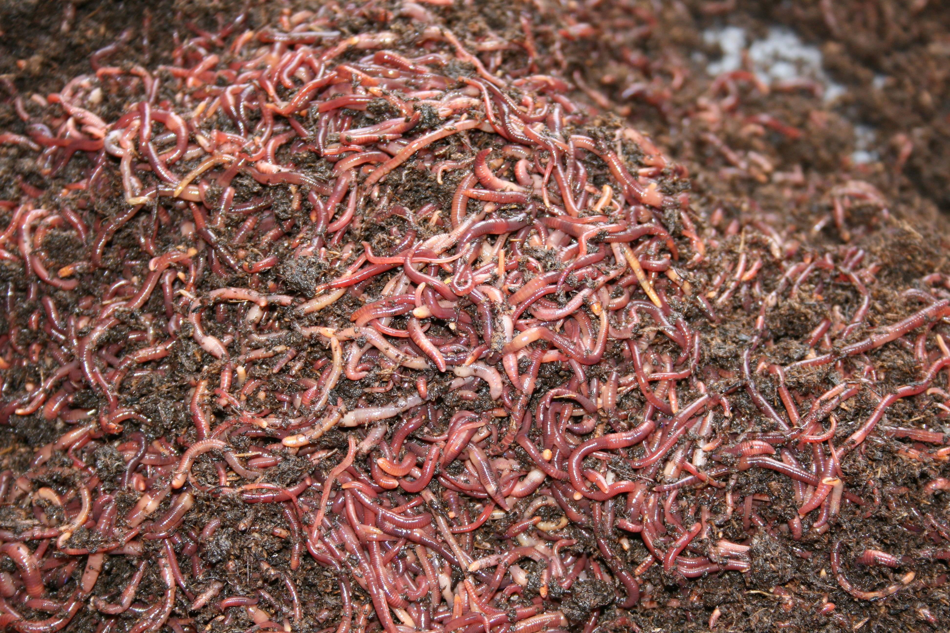
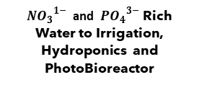
Processing Area Schematic
© 2015 Trapanese Engineering 2.0, U.S. Patent No. 62-723,351; Foreign Patents Pending.
Biochar to be Used as Fertilizer and Battery Capacitor Material
in Agrarian and Mild Industrial Areas
CO2 to Algal
PhotoBioreactor and containment for Sale
${{NO}_{3}}^{1−}$ and ${{ PO}_{4}}^{3−}$ Rich Water to Irrigation, Hydroponics and PhotoBioreactor
Sulphur
Scrubber
Red Worm
Composting/ Chicken Feed
Methane to CO2
Conversion
Graywater From
Kitchen and Bath
Graywater
Biodigester
Digester
CH4
Cl2/O2
Secondary
Treatment
Mixing Tank
Washdown Water
From Animals
Sulphur to Collection for Application to Electric Battery Functions
Recaptured Water
from Irrigation and
Aquaponics
Digester Sludge to Macerator
CO2
CO2
CO2
CO2
Biochar to Replenish
Activated Carbon
Tank as Needed
CO2
Tank
CO2
Tank
Primary Wastewater
Treatment Phase
Sand/DE
Filter #1
Sand/DE
Filter
#2
Secondary Wastewater
Treatment Phase
CO2
Tank
Raw Sewage
Sand/DE
Filter #3
Algal
Photo-Bioreactor
Pharmaceuticals,
Nutritional Supplements. and Biofuels
Sewage Cl2
Pretreatment
Macerator
Closed Sewage
Perk’ Over
Crude Cellulose
Media
Activated
Carbon
Filter
(#4)
Electrical Energy
Circulated to
Living Modules
BioChar
Collector
Activated
Carbon
Filter
(#4)
Heated Potable water Recirculated to
Plumbed Kitchen
And Bath Module
Pyrolysis
and Gasifier
Chambers
Radiator
Reverse
Osmosis
Optional
(Post-Activated Carbon)
Water Distillation
3.0L
GM
Engine
Advanced
Wastewater
Treatment to
Potability
Algae
Dewatering
Unit
Hopper
Electrical
Generator
Potable water Recirculated to
Plumbed Kitchen
And Bath Module
Gas
Filter
Separate
Raw Sewage and
Solids Waste
Pyrolysis
High-Lipid Algae Product for Conversion to Biodiesel
Control
Panel
Electrical
Connection
Pyrolysis Platform
Algae Product for Human and Animal Nutritional Supplements
Optional UV Wall
(Interior Option in Living Structure)

Slide 11
Processing Area Schematic
© 2015 Trapanese Engineering 2.0, U.S. Patent No. 62-723,351; Foreign Patents Pending.
Biochar to be Used as Fertilizer and Battery Capacitor Material
in Agrarian and Mild Industrial Areas
${{NO}_{3}}^{1−}$ and ${{ PO}_{4}}^{3−}$ Rich Water to Irrigation, Hydroponics and PhotoBioreactor
CO2 to Algal
PhotoBioreactor
Sulphur
Scrubber
Red Worm
Composting
As Feed
Methane to CO2
Conversion
Graywater From
Kitchen and Bath
Graywater
Biodigester
Digester
CH4
Cl2/O2
Secondary
Treatment
Mixing Tank
Alternative CO2 Conversion as Battery Storage Medium
Washdown Water
From Animals
Sulphur to Collection for Application to Electric Battery Functions
Recaptured Water
from Irrigation and
Hydroponics
Digester Sludge to Macerator
CO2
CO2
CO2
CO2
Biochar to Replenish
Activated Carbon
Tank as Needed
CO2
Tank
CO2
Tank
Primary Wastewater
Treatment Phase
Sand/DE
Filter #1
Sand/DE
Filter
#2
Secondary Wastewater
Treatment Phase
CO2
Tank
Raw Sewage
Sand/DE
Filter #3
Algal
Photo-Bioreactor
Nutritional Supplements and Biofuels
Alcohol and BioGas Conversions
Yielding Saleable Surplus to
>$50M/Year
Sewage Cl2
Pretreatment
Macerator
Closed Sewage
Perk’ Over
Crude Cellulose
Media
Activated
Carbon
Filter
(#4)
Electrical Energy
Circulated to
End-Users
BioChar
Collector
Activated
Carbon
Filter
(#4)
Heated Potable water Recirculated to
End-Users
Pyrolysis
and Gasifier
Chambers
Radiator
Reverse
Osmosis
Optional
(Post-Activated Carbon)
Water Distillation
Algae
Dewatering
Unit
3.0L
GM
Engine
Advanced
Wastewater
Treatment to
Potability
Hopper
Electrical
Generator
Agrarian Waste
Potable water Recirculated to
End-Users
Gas
Filter
Separate
Raw Sewage and
Solids Waste
Pyrolysis
Control
Panel
Electrical
Connection
High-Lipid Algae Product for Conversion to Biodiesel
Pyrolysis Platform
Algae Product for Human and Animal Nutritional Supplements
UV Wall
(Interior Option in Living Structure)

Slide 12
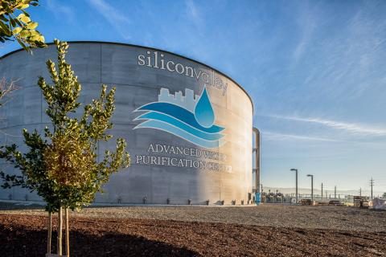
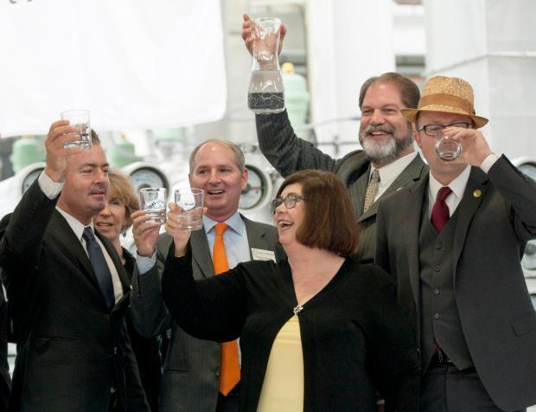
“Nanofiltration (NF) membranes have come a long way since it was first recognized in the late 80’s.”
Source: Science Direct/Elsevier 15 January 2015, Pages 226-254 https://www.sciencedirect.com/science/article/abs/pii/S0011916414005773
Legislators, landfill managers, common current wastewater treatment facility managers and technicians are fearful of or governed by an inferior system. The following is a few of the far too personal reasons that all these individuals refuse to rise to the challenge of championing the true cause of ecological, sociological, and economical sustainability:
  They don’t want to learn anything “new” (100-year-old proven technology); this would cause the legislators and bureaucrats in planning department jobs to have to specify anything that has been proven in the last 100 years, which work better than archaic early 20th century wastewater management practices that are still “on the books”, and have not been properly updated to reflect reasonably current, proven technologies.
  They don’t want an unanticipated disaster (someone getting sick from mismanagement of pathogen-laden wastewater) to happen “on their watch” – meaning under the legislators’ administrations.
In contrast, Valley Water and all of Orange County have both operated as the flagship, proof-of-concept RO/NF wastewater treatment facilities in California to prove that RO/Nano Filtration are the proper ways to manage wastewater.

Slide 13
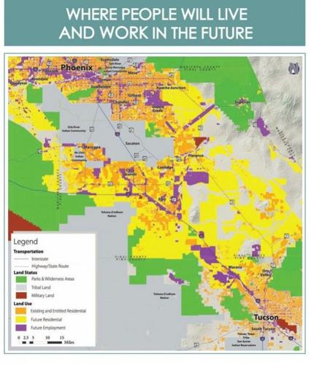
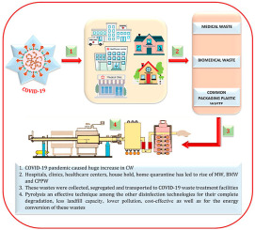
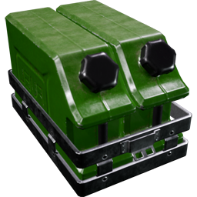
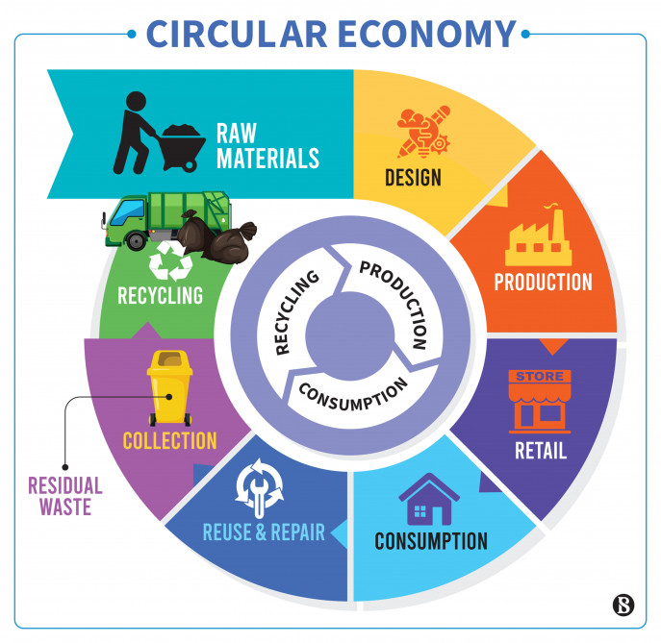
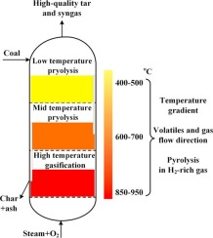
Solids wastes from wastewater, onsite agriculture, and landfill are to produce biofuels, biogases, and biochar that are to be utilized throughout the system, and surplus is to be packaged and sold to augment the community’s financial power.
It is imperative that it be understood here that the processes for the conversion of pathogen-laden sewage, as well as any other biofuel feedstock as listed previously, is rendered completely free of any threat of pathogen contamination due to the elements of the biofuel-producing system.
Pyrolysis, integral to the generation of biofuels from all types of solids wastes, is the incineration of all listed feedstocks in the absence of oxygen at temperatures and durations that virtually no pathogen could survive.
Another good point to note here is that the overall circular economy design as illustrated in the animated slide is suited to development in desert regions around the world. This plan is to be built in Central Arizona, in the path of development, centered on the two-hour drive between Phoenix and Tucson – the two major metro areas of Arizona.

Slide 14
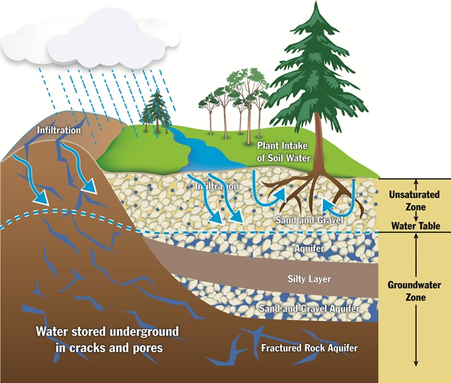
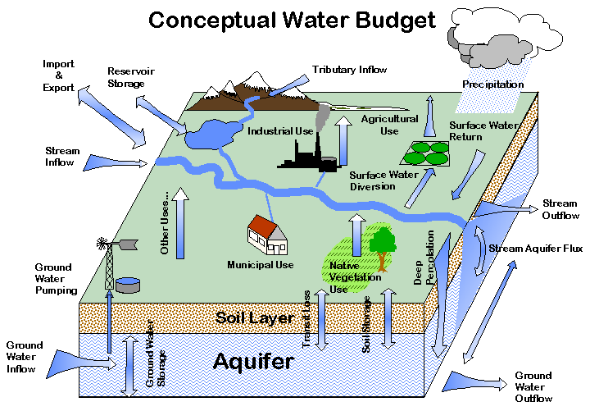
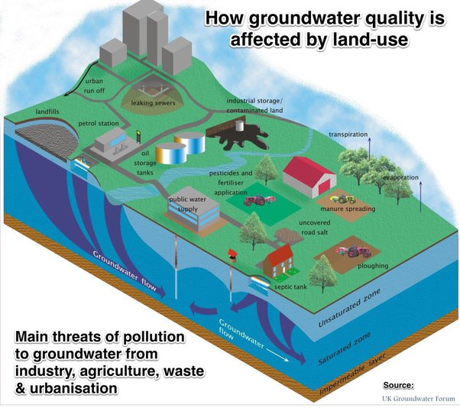
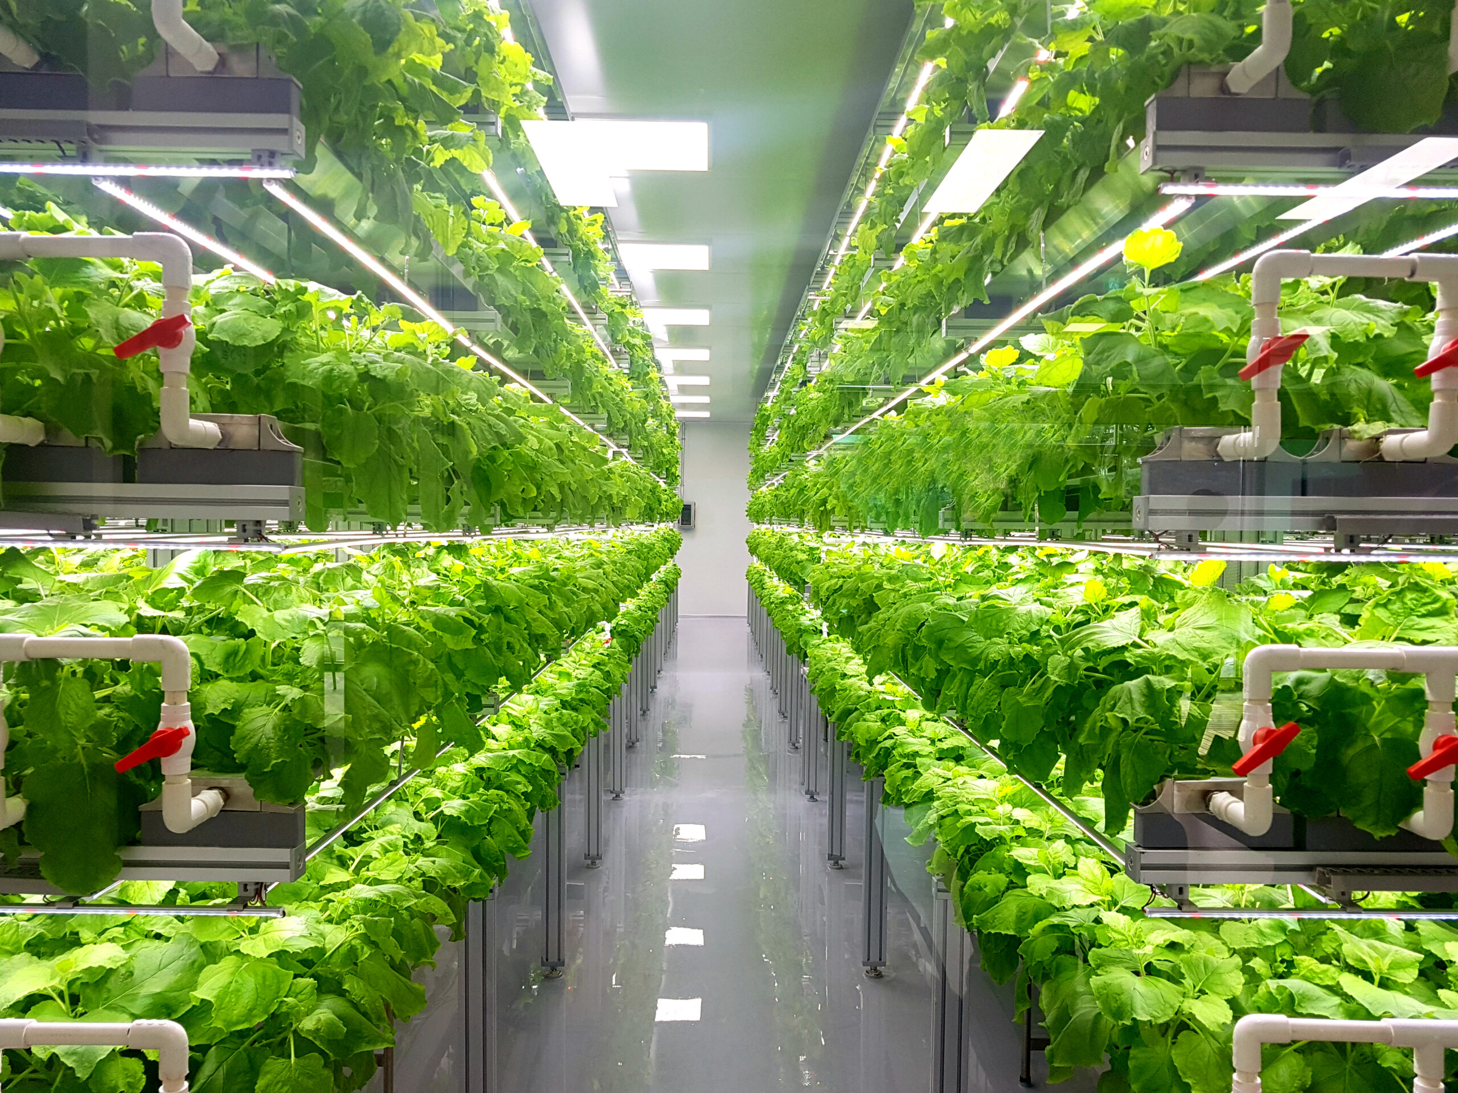
This is one of very few development solutions suited to desert regions, as water is to be extracted once, and perpetually recirculated.
Occasional replenishment of water due to minimized losses of water to evaporation (minimized by employing CEA - Closed Environment Agriculture) is to be achieved with water capture during the monsoon seasons. Water losses to CEA are <1% of the total volume used per harvest.
Note the distinction between current inferior solutions to bring and manage water for use by new and growing communities in Southwestern states. It is not to be extracted from the aquifer without regard for proper immediate recharging of the aquifer, nor used, partially-treated, and dumped into to aquifer through a loose percolation concept that is not adequately managed demonstratable as inferior for the following reasons:
Water percolating through the soil into the aquifer is negatively restrained in the soil and therefore not readily and suitably recharging the aquifer, causing false aquifer recharging stations to be expensively installed and federally managed by the EPA without regard for costs.
The quality of the partially-treated wastewater that does make its way to the aquifer is tainted with chemicals and compounds that are detrimental to the ecology.

Slide 15
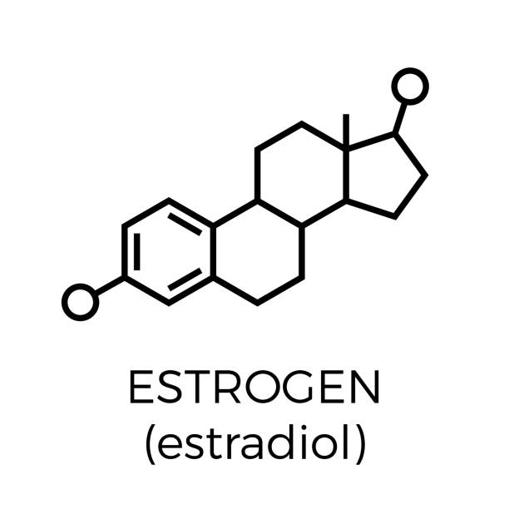
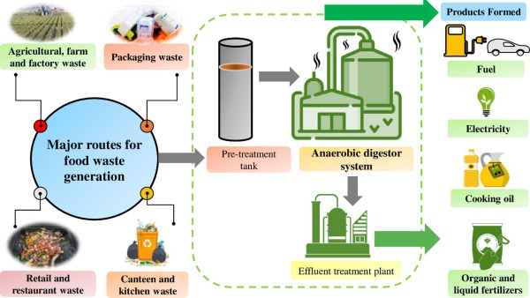
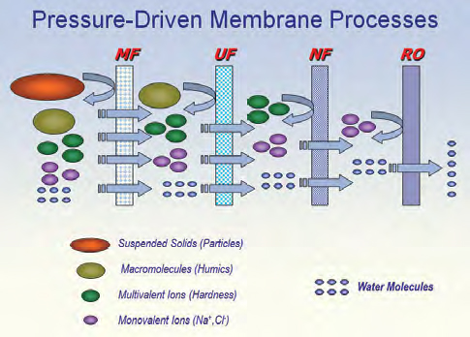
In contrast, Nano Filtration removes the smaller molecules, such as the hormones commonly found to be problematic as those that appear in the aquifer and other otherwise fresh water sources, as these hormones are known to be relatively small, difficult-to-remove molecules. They make their way to these otherwise healthy water sources due to the passing of these hormones through the population in their urine.
Nano filtration is a technology in which pure water is the only recirculable effluent from this superior system. NF is costly, as the average pressure to fully treat wastewater to potability is 140,000 psi in this latter NF phase of the purification–to-potability process. Consequently, the energy required to achieve this level of purity to a community-serving daily volume of potable water does draw a significant amount of electrical energy.
It is important to note here that the costs of electrical energy for Nano Filtration is offset by the production of biofuels generated by the myriad of sources: landfill, sewage solids, agricultural wastes, etc.

Slide 16
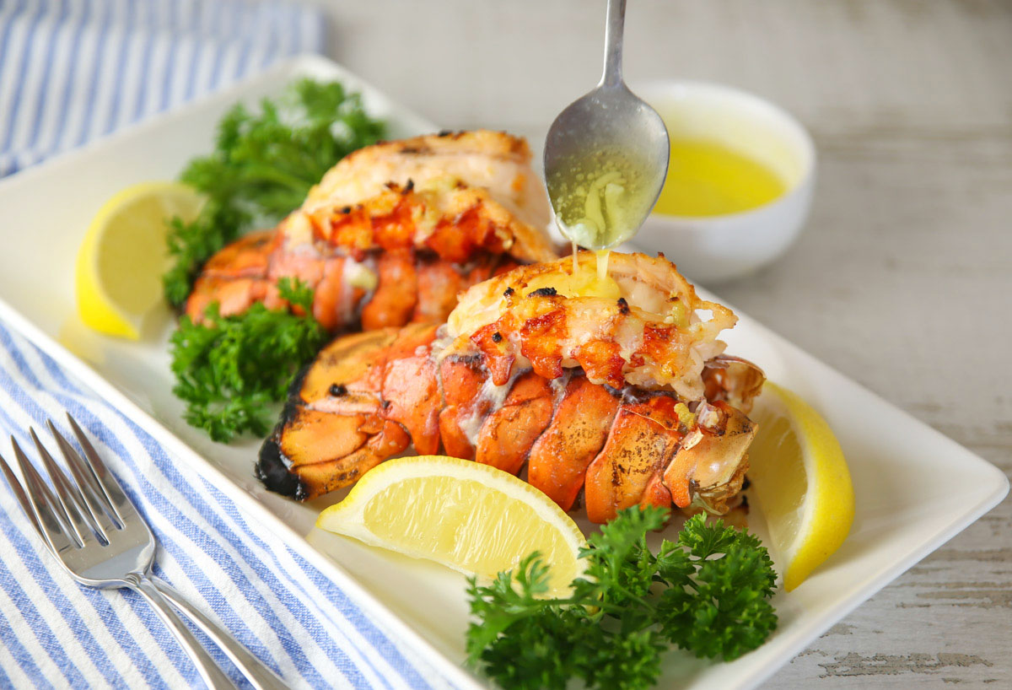
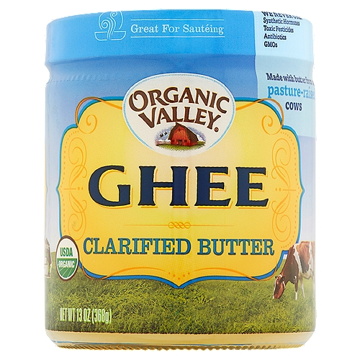


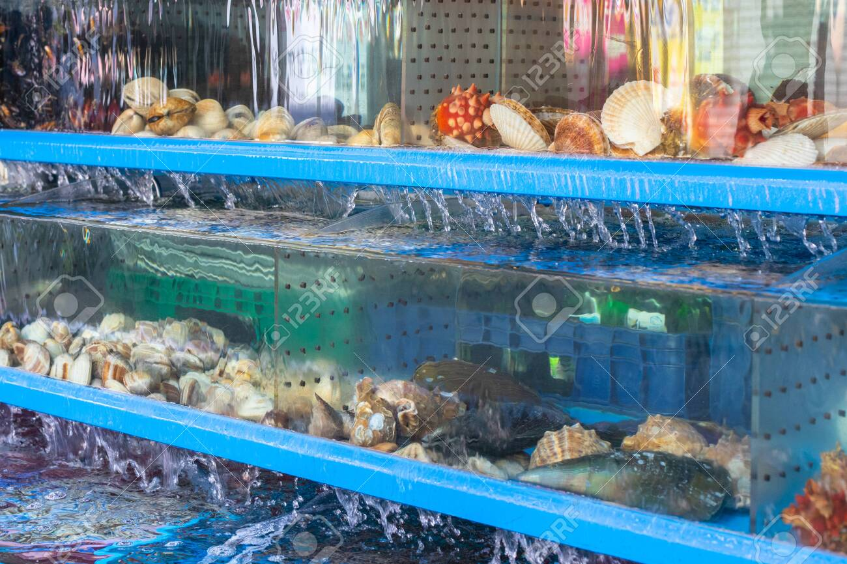
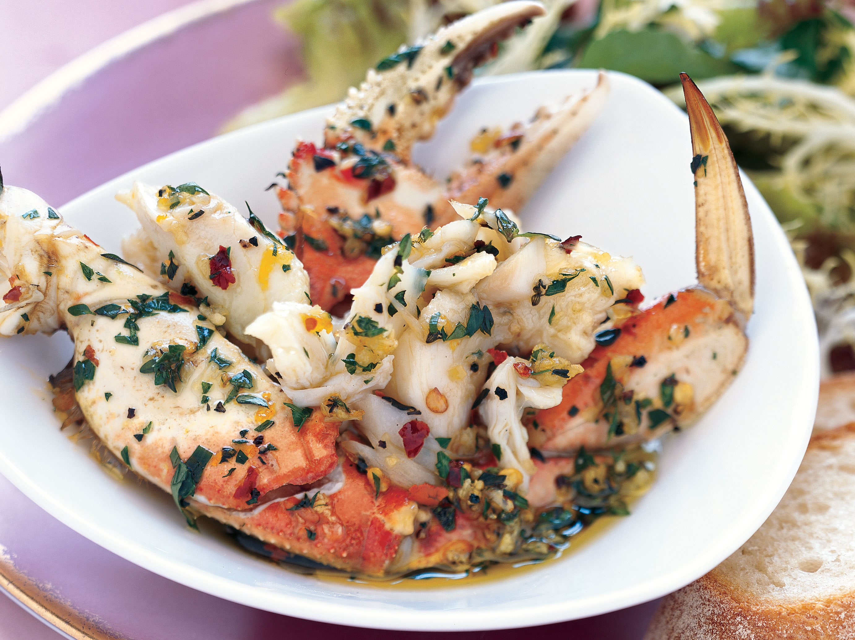
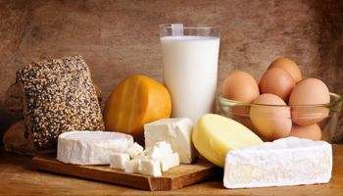
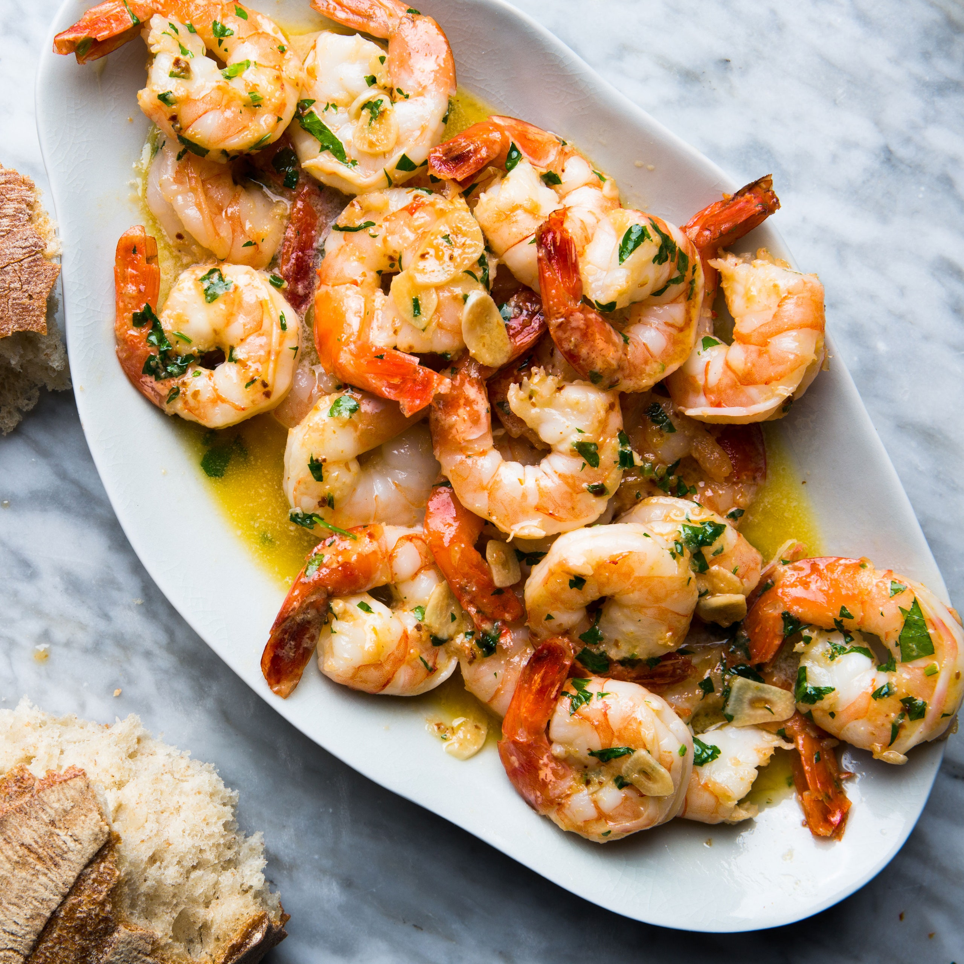

The agriculture of an individual master planned community of this design is ideally that of Natural Law in its spiritual sense. Therefore, Karma-free/suffering-free diets are easily accommodated while generating a voluminous variety of biofuel processing feedstocks.
Raw milk from untreated cows, unfertilized eggs from free-range chickens, fin-fish grown in its own aquaponics cycle, some sheep and goat dairy products are among the favored protein sources in addition to the more standard cows’ milk in the US.
Additional dairy products such as ghee, butter, ice cream, cheeses, can be consumed on a cruelty-free diet.
In as much as the consumption of crustaceans deviates from biblical tenets, a caveat for the consumption of crustaceans is to be considered. As shrimp, lobsters, and crab are currently associated with luxury, and the biblical reasons for not consuming them in the past have to do with the notion that those animals are bottom-feeders. However, properly farmed and fed well-managed feed in clean tanks precludes this notion that they are too foul to eat.
Crustaceans would live in clean, state-of-art aquaponics tanks. Clean farming is to be associated with the master planned community aquaponics. Therefore, they ought to be eminently consumable to anyone who wants to enjoy crustacean dishes.

Slide 17
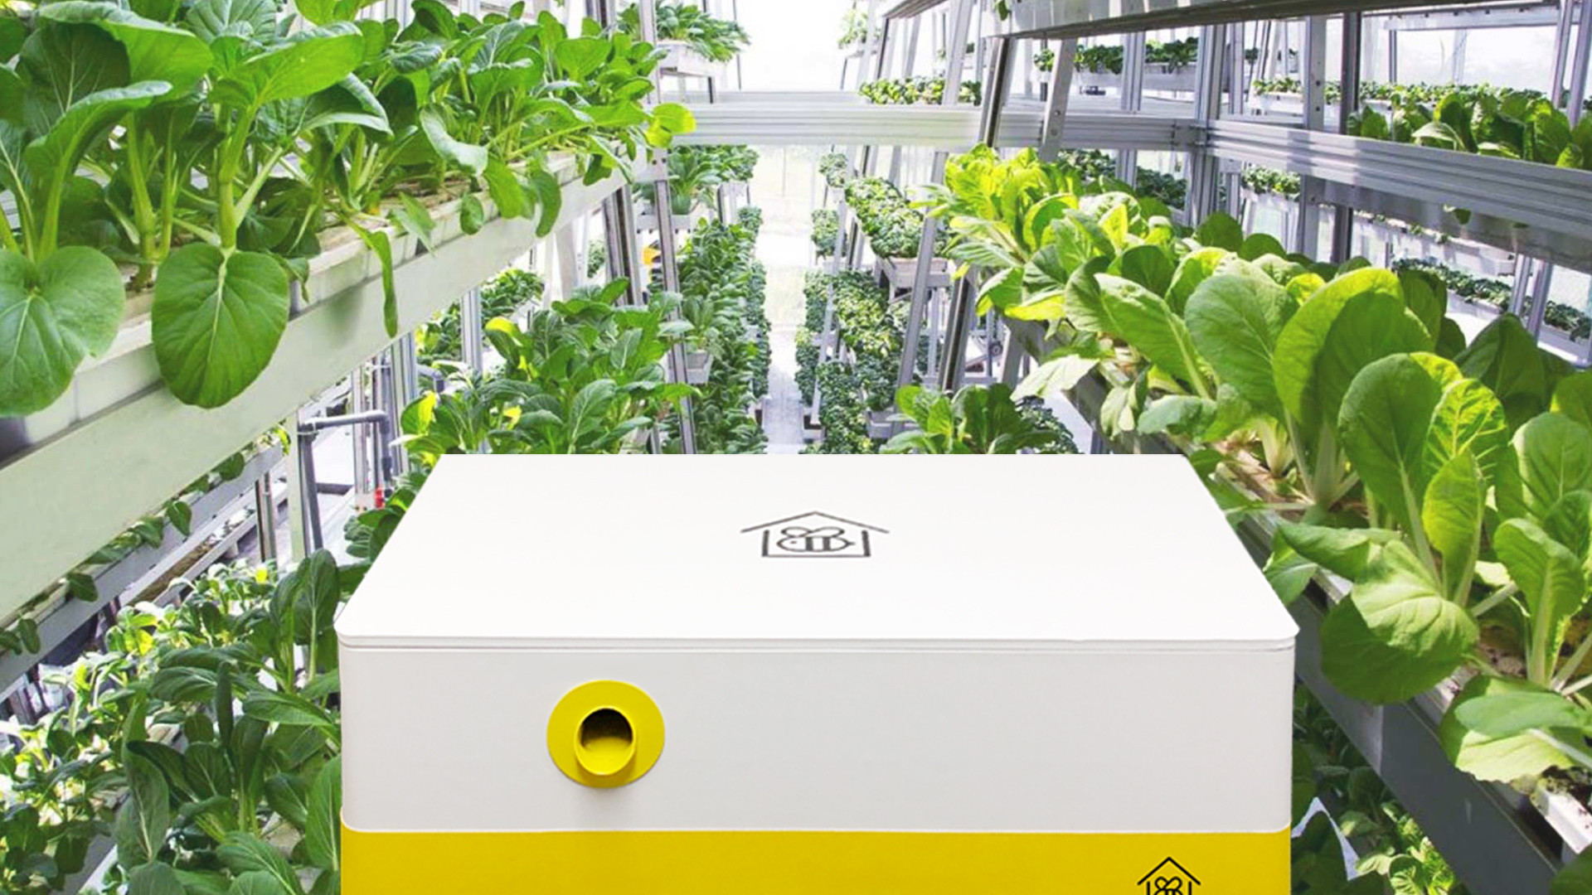
Bee keeping is possible in CEA/Vertical Agriculture environments and greenhouses.

Slide 18
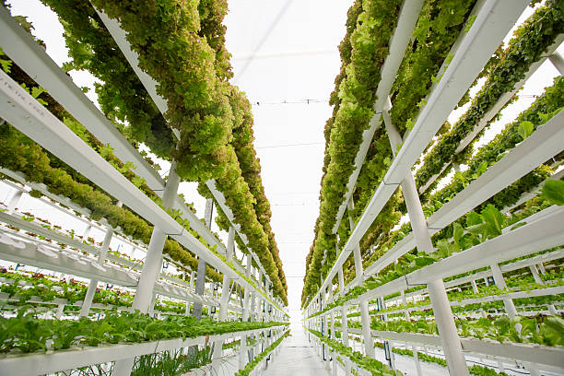
Bee keeping is possible in CEA/Vertical Agriculture environments and greenhouses.
A truly controlled environment achieves the elimination of the dangers of exposing one’s bees to unwanted chemicals found in widely used pesticides.

Slide 19
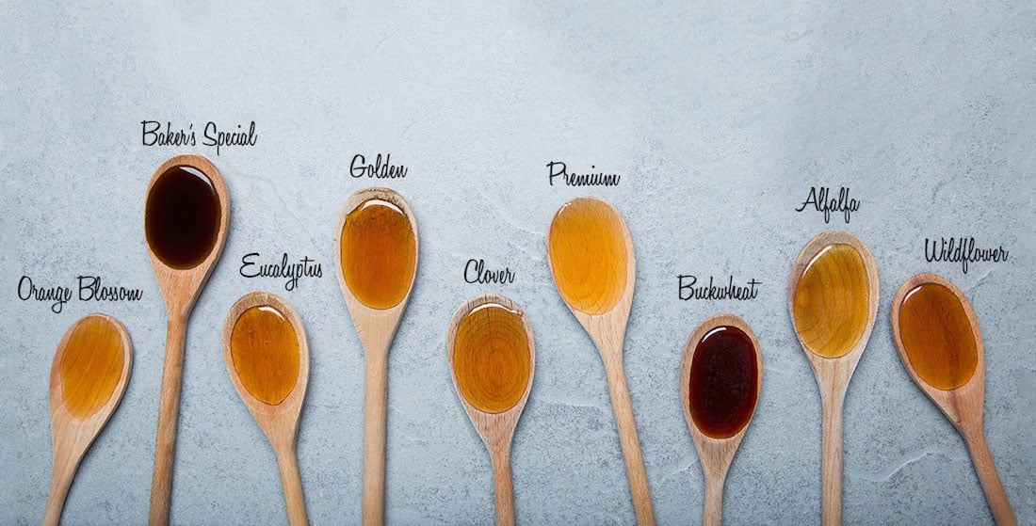
Bee keeping is possible in CEA/Vertical Agriculture environments and greenhouses.
A truly controlled environment achieves the elimination of the dangers of exposing one’s bees to unwanted chemicals found in widely used pesticides.
It can also allow for a unique series of honey flavors marketable as a plentiful and properly-controlled and safe food product as an income stream for the broader economy of the planned community or individual investors.

Slide 20
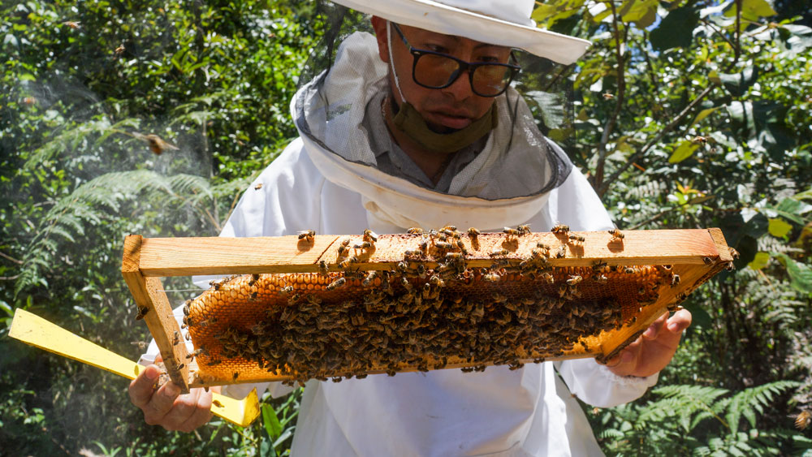
Bee keeping is possible in CEA/Vertical Agriculture environments and greenhouses.
A truly controlled environment achieves the elimination of the dangers of exposing one’s bees to unwanted chemicals found in widely used pesticides.
It can also allow for a unique series of honey flavors marketable as a plentiful and properly-controlled and safe food product as an income stream for the broader economy of the planned community or individual investors.
Farmers and their investors will have a particular advantage of the protected environments thereby ensuring their markets that their products are the safest and most healthy.

Slide 21
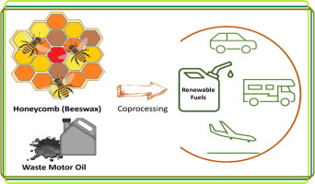
Bee keeping is possible in CEA/Vertical Agriculture environments and greenhouses.
A truly controlled environment achieves the elimination of the dangers of exposing one’s bees to unwanted chemicals found in widely used pesticides.
It can also allow for a unique series of honey flavors marketable as a plentiful and properly-controlled and safe food product as an income stream for the broader economy of the planned community or individual investors.
Farmers and their investors will have a particular advantage of the protected environments thereby ensuring their markets that their products are the safest and most healthy.
These apiarists can also be assured that they can readily eliminate their business’ wastes, as all residents and business owners are able, because the particular value of honey and beeswax, when not utilized for sale, can be used as feedstocks for the generation of biofuels.
Source: https://www.sciencedirect.com/science/article/abs/pii/S0016236122041436

Slide 22
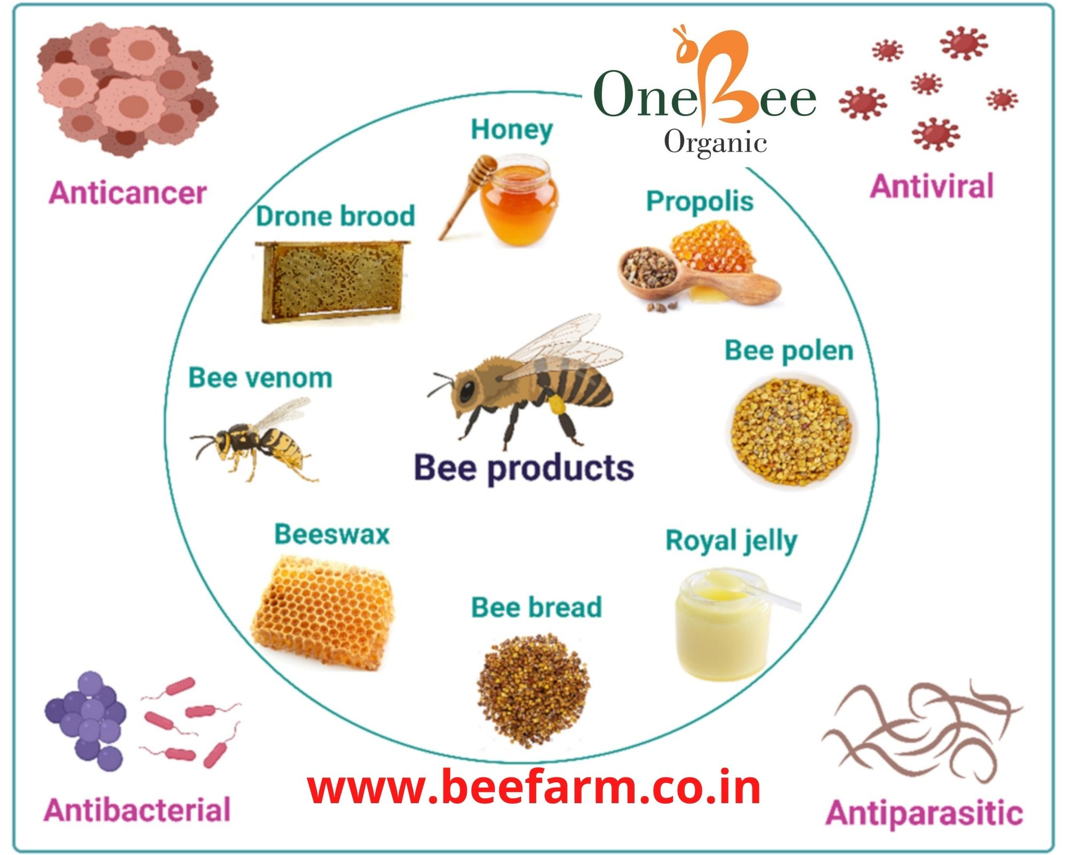

Bee keeping is possible in CEA/Vertical Agriculture environments and greenhouses.
A truly controlled environment achieves the elimination of the dangers of exposing one’s bees to unwanted chemicals found in widely used pesticides.
It can also allow for a unique series of honey flavors marketable as a plentiful and properly-controlled and safe food product as an income stream for the broader economy of the planned community or individual investors.
Farmers and their investors will have a particular advantage of the protected environments thereby ensuring their markets that their products are the safest and most healthy.
These apiarists can also be assured that they can readily eliminate their business’ wastes, as all residents and business owners are able, because the particular value of honey and beeswax, when not utilized for sale, can be used as feedstocks for the generation of biofuels.
Honey is not only a natural preservative, honey and beeswax is used in the medical industry, as it has natural antibacterial elements prized for the acceleration of the healing process.

Slide 23
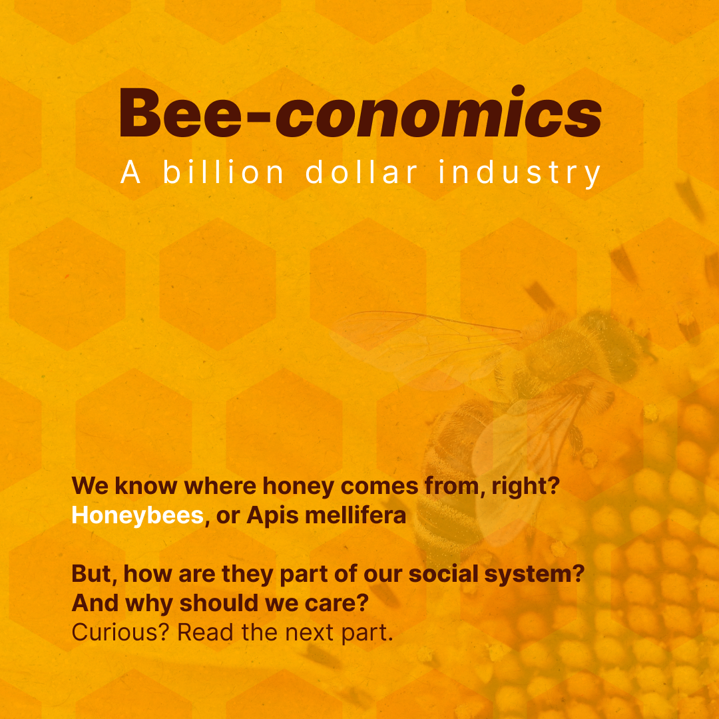
Bee keeping is possible in CEA/Vertical Agriculture environments and greenhouses.
A truly controlled environment achieves the elimination of the dangers of exposing one’s bees to unwanted chemicals found in widely used pesticides.
It can also allow for a unique series of honey flavors marketable as a plentiful and properly-controlled and safe food product as an income stream for the broader economy of the planned community or individual investors.
Farmers and their investors will have a particular advantage of the protected environments thereby ensuring their markets that their products are the safest and most healthy.
These apiarists can also be assured that they can readily eliminate their business’ wastes, as all residents and business owners are able, because the particular value of honey and beeswax, when not utilized for sale, can be used as feedstocks for the generation of biofuels.
Honey is not only a natural preservative, honey and beeswax is used in the medical industry, as it has natural antibacterial elements prized for the acceleration of the healing process.
Honey is to be used as another income steam/investment tranche for its food, cosmetic, and pharmaceutical values.

Slide 24
It is imperative that legislators UNDERSTAND this imperative that we need to have our sustainable current model master planned community infrastructure brought into this century NOW.
Sewage treatment plants continue to release sulfurous odors due to the inferior current wastewater treatment protocols. This is the reason that they are relegated to an industrial zone
It needs to be understood by the legislators that there is no further need to relegate wastewater treatment to an industrial area if current engineering practices are employed. Understanding and reasonable resultant approvals to decentralize wastewater treatment is to be allowed by simply stipulating that responsible engineers design the system, and responsible technicians manage the overall facility from early phase treatment to the long-since-proven Advanced Wastewater, RO/NF processes.
Releasing into the atmosphere and burning of the sulfur-laden methane is as old as the rest of the inferior waste treatment practices. Of course it’s is going to be malodorous under slovenly, irresponsible current engineering parameters.
A properly updated sewage treatment system has absolutely no such ill effects, and all noxious fumes are contained. Their chemical elements, currently allowed to be vented into the air, are reclaimed and applied to battery function and other industrial uses, and in the process of transporting these chemicals, there are proper safeguards that preclude their inadvertent release into the environment.

Slide 25
It is only due to the limitations on the parts of the planning department bureaucrats that fully competent engineers are put in the position of having to install intelligent systems on-the-sly for the occasional one-off solutions as it may be applied to an individual homestead or rural properties.
It has been proven time-and-time-again that legislation is the choke point of all sensible sustainable answers to typical solutions.
New Master Planned community Designs must include the Circular Economy as described in this presentation:
All wastes to biofuels, biogases, and biochar
Biofuel is to be economically routed throughout the system and saleable surplus is to be sold for further income streams
All listed agrarian industries are to be included in the master planned community, thereby providing ongoing food security to the community and the self-sustaining cultural park to minimize dependency on trucked-in foods
Recreation in the form of a waterpark, a cultural park, and other recreational facilities that draw others to the region are to be implemented to generate economic development.
I will continue in my mission to redirect the current bureaucracy into conforming to sensible science and engineering. Our society merely needs well-trained technicians of properly sincere demeanor and a sense of responsibility as many such technicians already exist. We need to give these properly-trained technicians and engineers adequate responsibility to continue to do their good work without interference of blind, mindless bureaucrats who currently foolishly dictate wholly archaic and ecologically harmful methods that also generate threats to the public’s health.

